Slide 2
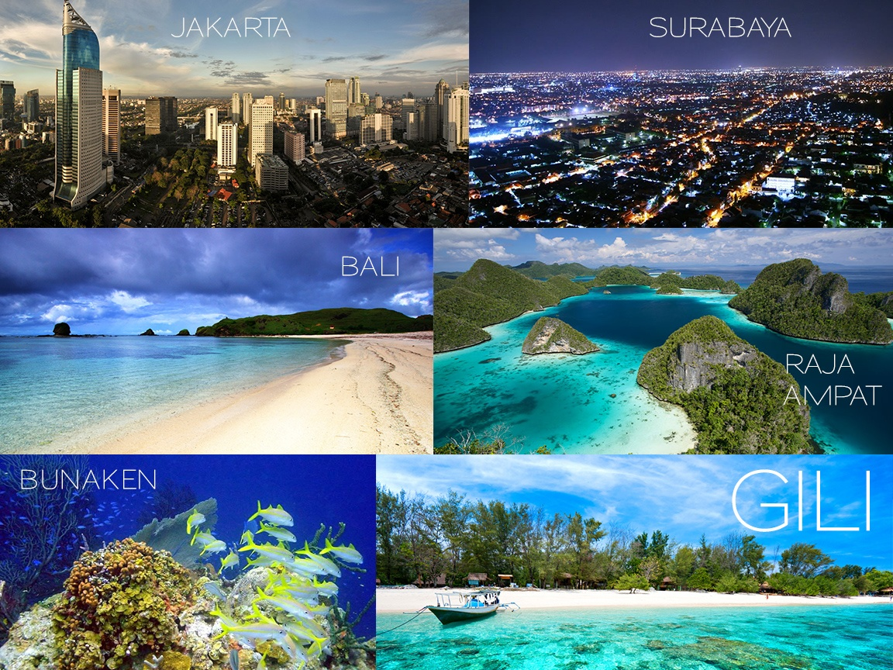
TOURISM INDUSTRY in INDONESIA

Slide 3
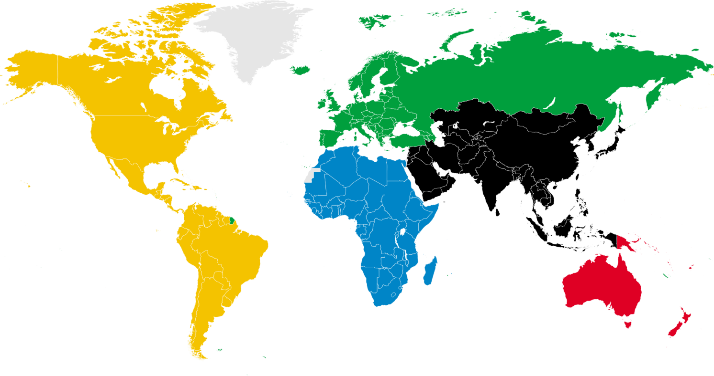
TOURISM INDUSTRY in INDONESIA
TOURIST ARRIVAL IN INDONESIA BASED ON COUNTRY ORIGIN
Europe 1.045K
America
297K
Asia Pacific 2.814K
2011

Slide 4
TOURISM INDUSTRY in INDONESIA
TOURIST ARRIVAL IN INDONESIA BASED ON COUNTRY ORIGIN
Europe 1.108K
Eropa 1.045K
America 312K
Asia Pacific 3.058K
Amerika 297K
Asia Pasifik 2.814K
2012

Slide 5
TOURISM INDUSTRY in INDONESIA
TOURIST ARRIVAL IN INDONESIA BASED ON COUNTRY ORIGIN
2009
America 229K
Europe 978K
Asia Pacific 2.192K
2010
America 258K
Europe 1.038K
Asia Pacific 2.481K
2011
America 297K
Europe 1.045K
Asia Pacific 2.814K
2012
America 312K
Europe 1.108K
Asia Pacific 3.058K
+15% per year

Slide 6
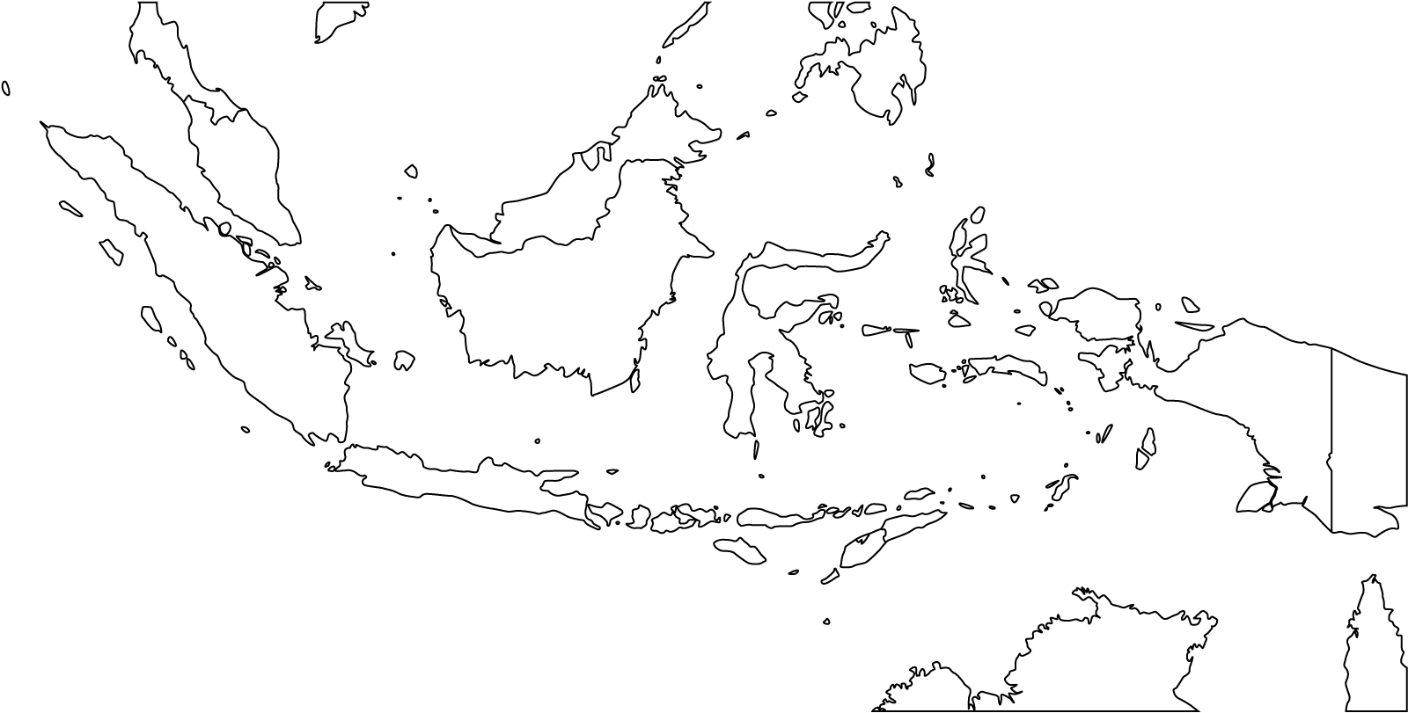
TOURISM INDUSTRY in INDONESIA
What is the most popular tourist destination in Indonesia?

Slide 7
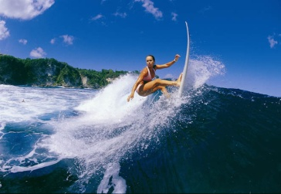
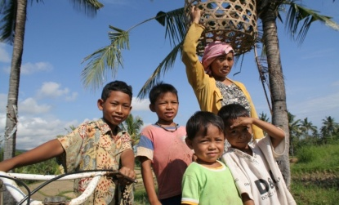
BALI
Began 20 years ago in the area of Nusa Dua, Bali's tourism industry continues to climb.
What makes Bali so well known?
Exotic beach and perfect wave to surf on
Open minded people and tolerant.
Unique and well-preserved culture

Slide 8
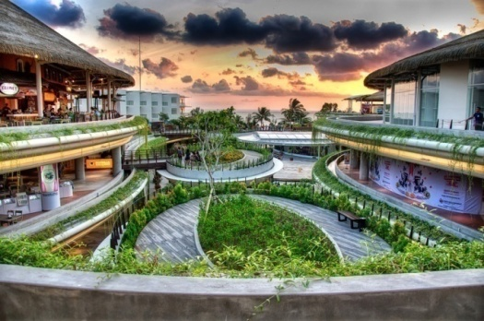
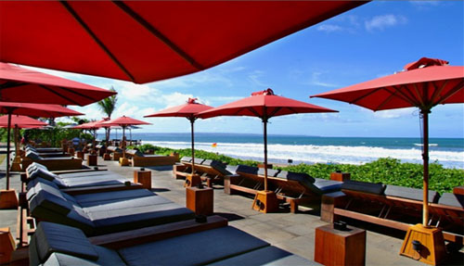
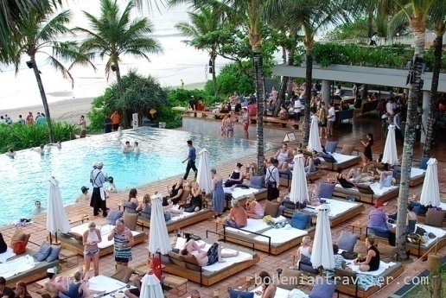
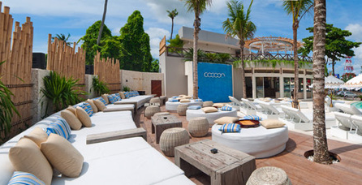
BALI
Beach Walk Mall
Kudeta Oberoi
The most popular area in Bali
Kuta
Seminyak
Petitenget
Potato Head
Cocoon Beach Club

Slide 9
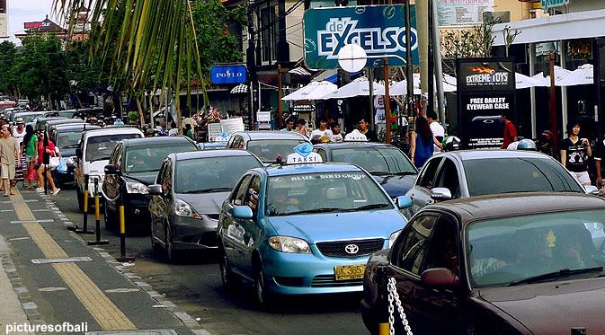
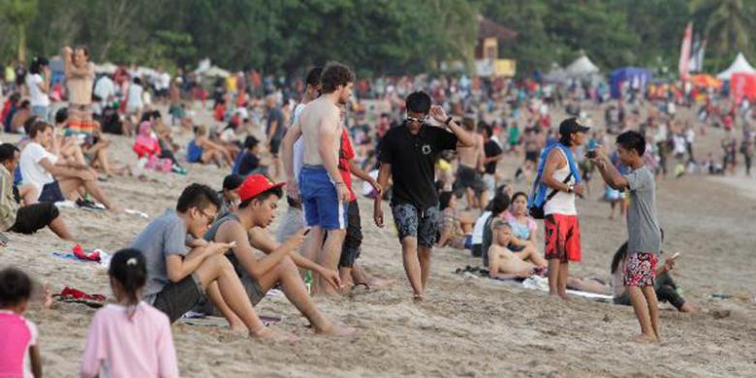
BALI
The development of construction in Bali can not be inevitable. The number of tourist arrivals continue to rise each year. But Bali is still Bali, a small island with a population that continues to increase. As with other tourism regions throughout the world, Bali is slowly but surely becoming increasingly crowded, busy, and polluted.
Is everybody ready to wait for 1 hour for the sake of a seat at Potato Head Beach Club?

Slide 10
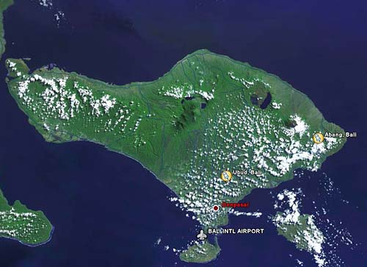
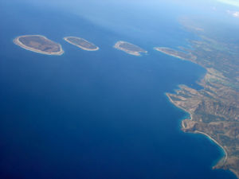
BALI to GILI & SIRE LOMBOK
Crave a quiet tourist place, with a beautiful beach and safe for swimming, tourists and investors begin to look Gili Island and Lombok Sire.
30 minutes by flight
90 minutes by boat

Slide 11
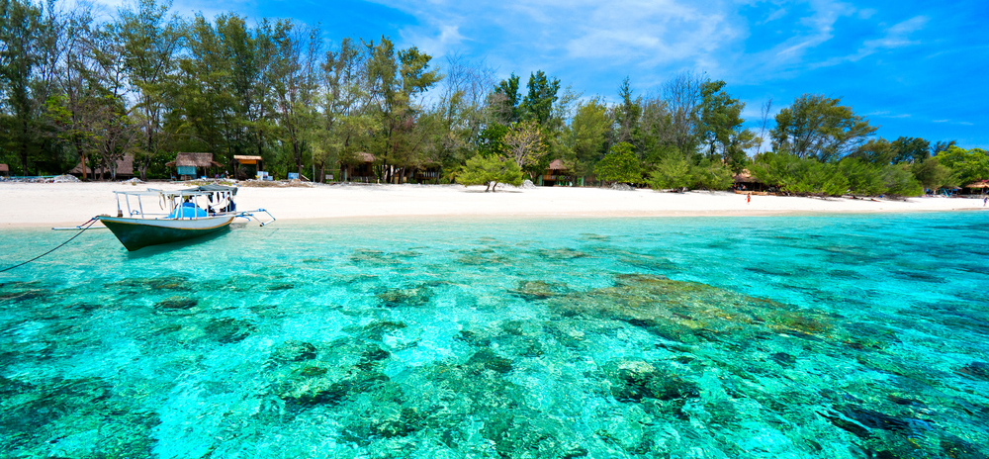
THE BEAUTY OF GILI & SIRE LOMBOK

Slide 12
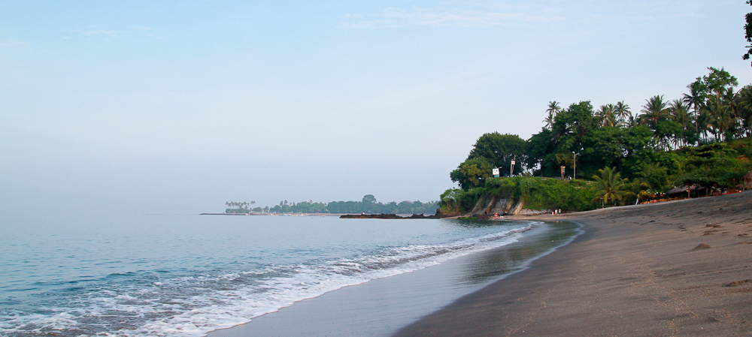
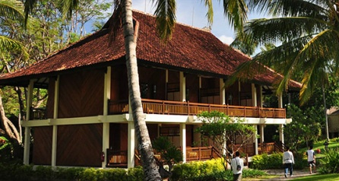
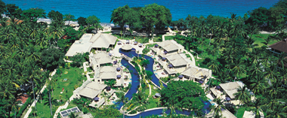
LOMBOK
About 10 years ago, began the development of tourism in Lombok Senggigi beach area pioneered by Sheraton Group. Then many hotels and villas that follow. Until today there are more than 50 hotels in Senggigi area.
Pantai Senggigi
Senggigi Beach Hotel
Sheraton Hotel Senggigi

Slide 13
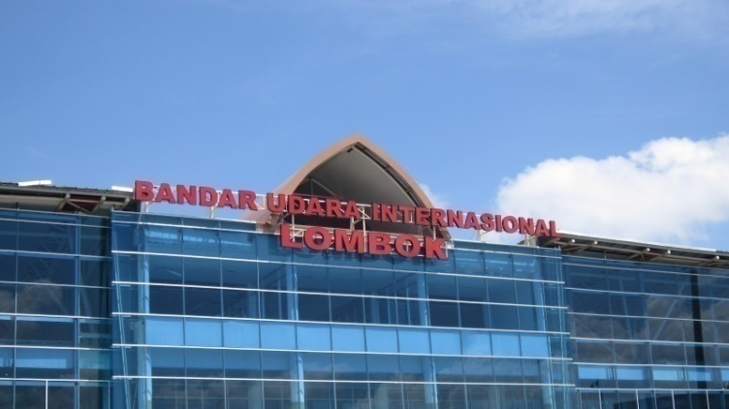
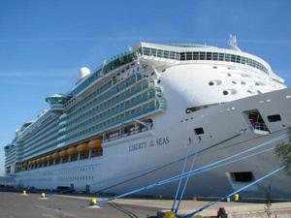
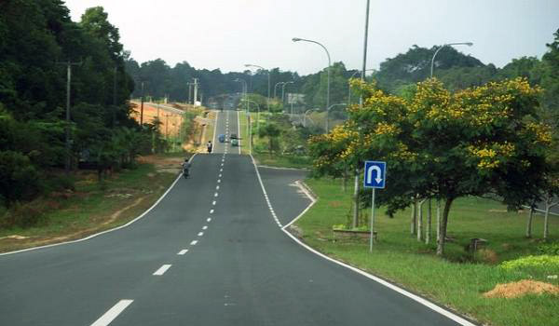
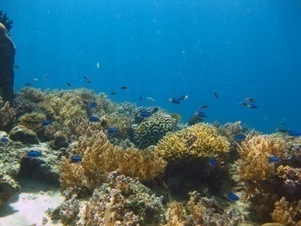
LOMBOK
The development of tourism in Lombok supported by infrastructure development by the government.
Lombok International Airport
Direct flight international : Singapura, Malaysia, Australia
Direct flight domestic: Jakarta more than 10 flights per day) , Surabaya, Bali
Cruise dock in Bangsal, North Lombok
Brand new road infrastructure
Lombok International Airport
Cruise dock, Bangsal
5 years ago Gili were in the top 10 diving spots in the world
New road

Slide 14
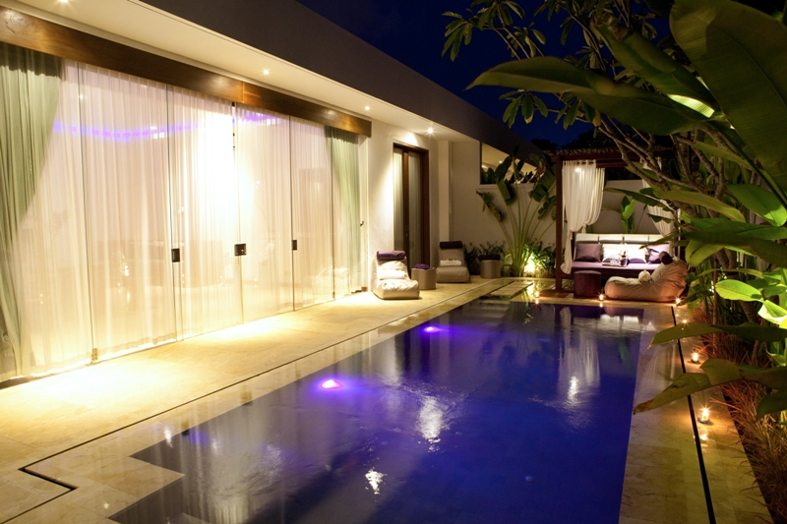
DEVELOPER PROFILE
PT. ANEMA
Anemalou Villas & Spa Bali
PT. Anema is a group of property developers from Hong Kong and France. It has been experienced in the development of high class properties in France, Hong Kong, Bali.

Slide 15
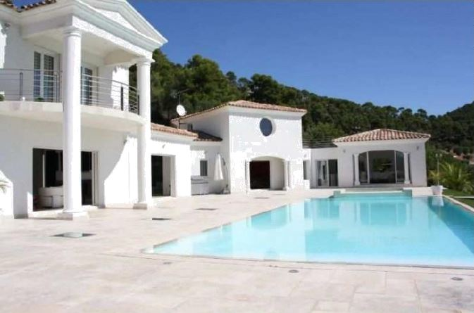
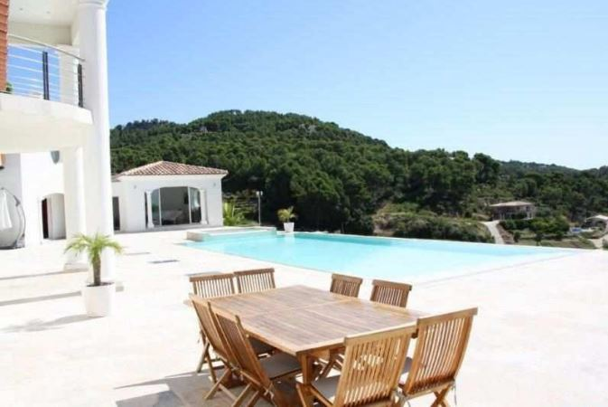
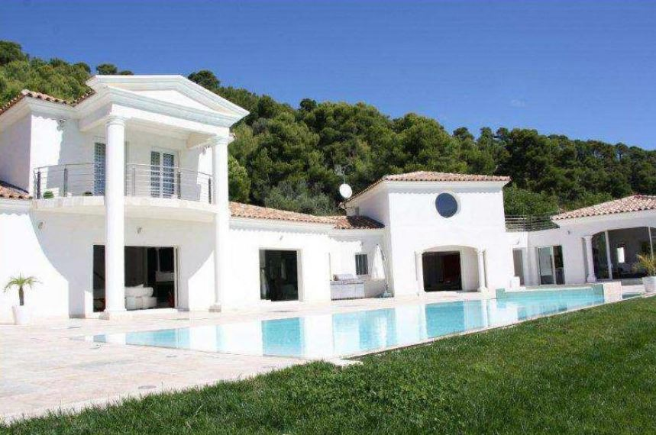
FRANCE

Slide 16
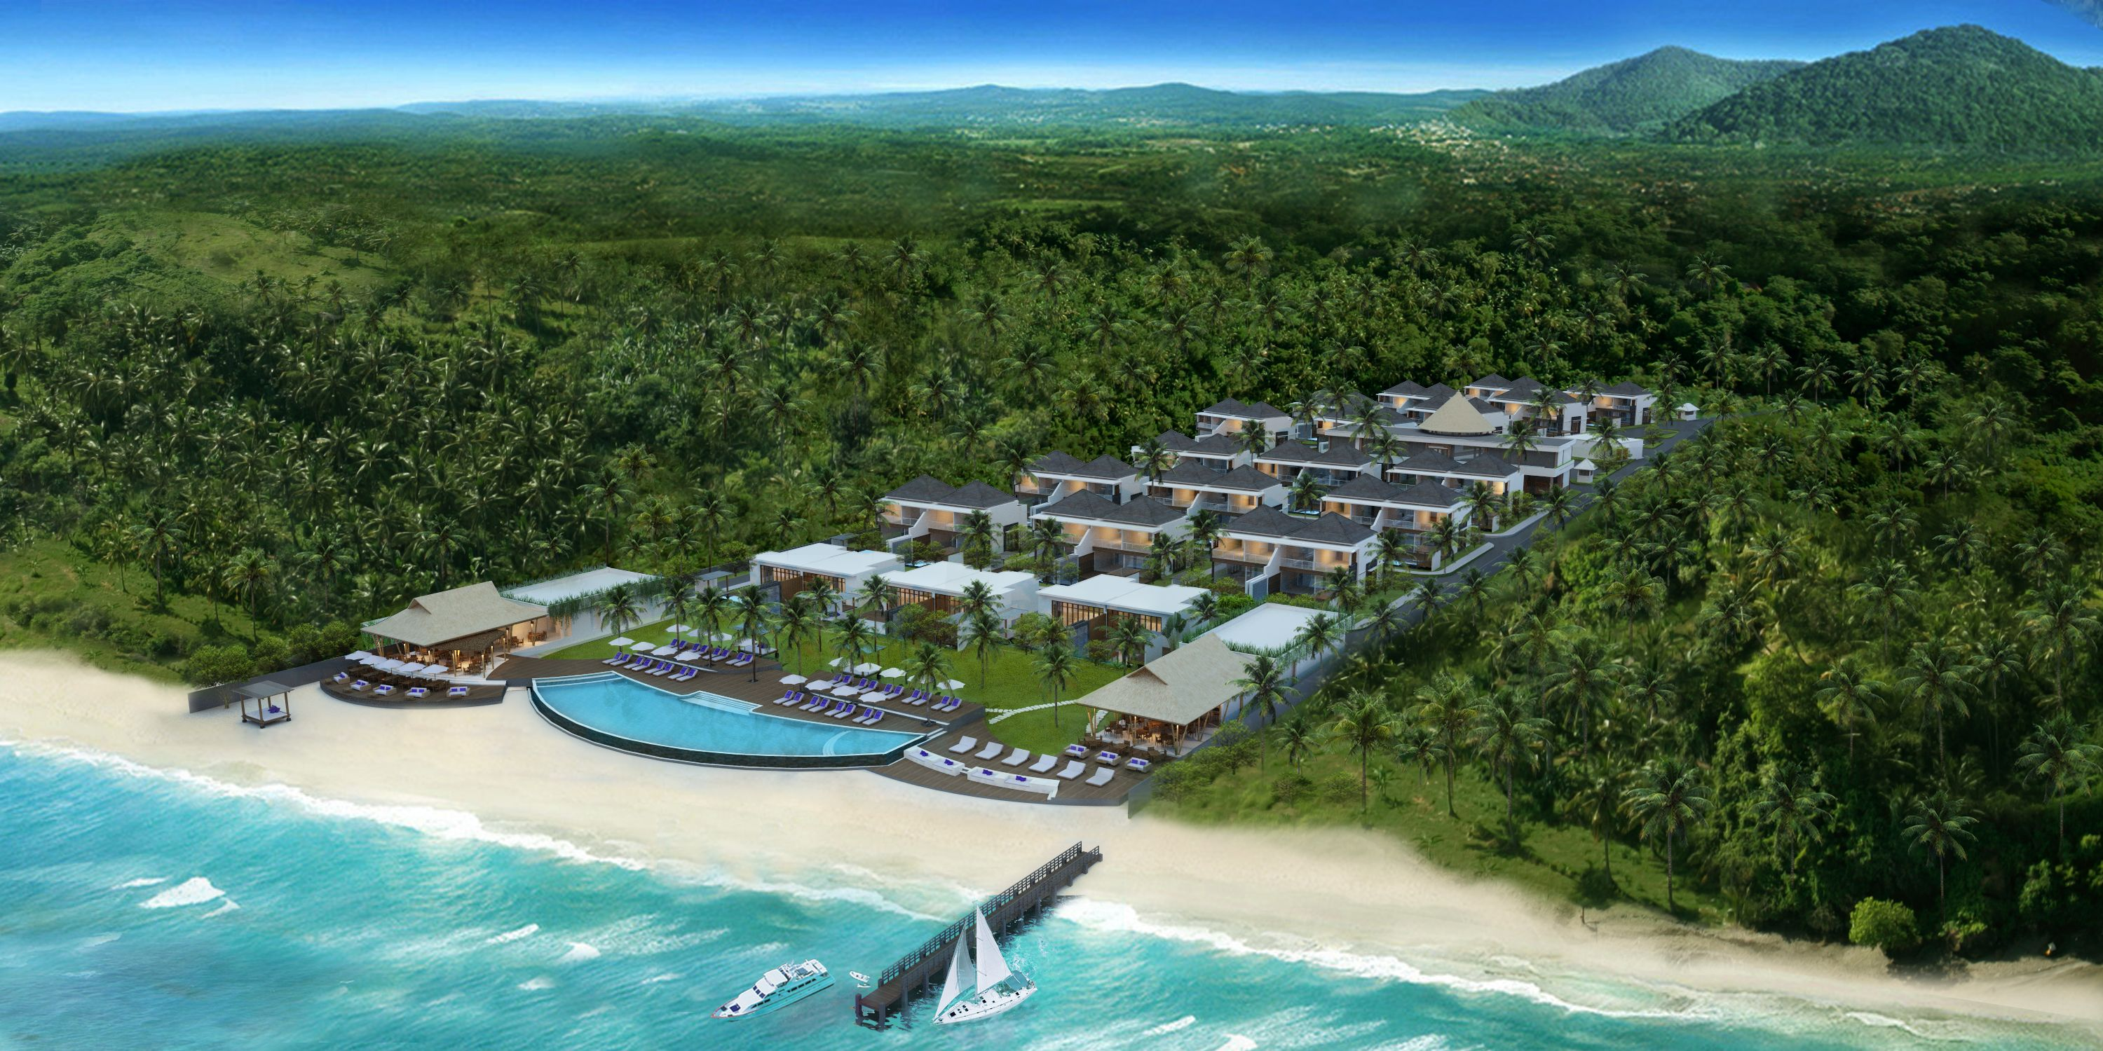
Anemalou Resort & Beach Club Sire Lombok

Slide 17
OPENING JUNE 2016

Slide 18
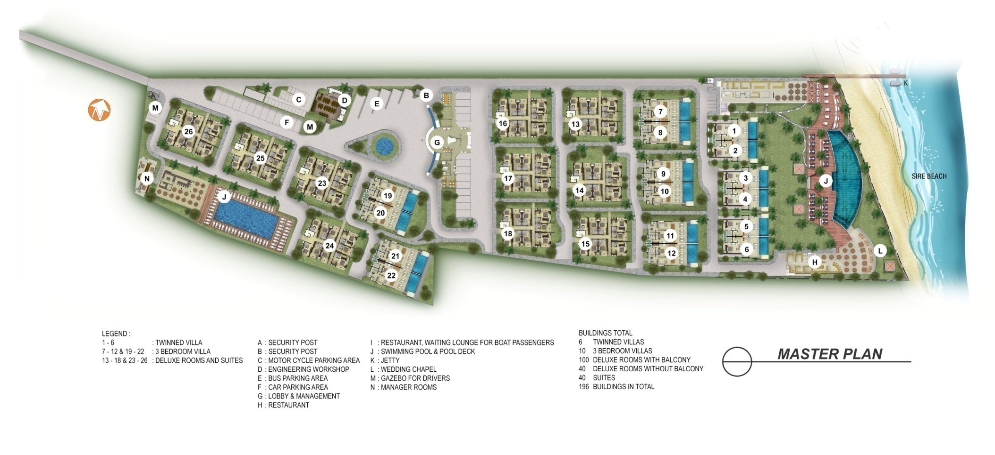
MASTER PLAN

Slide 19
GROUND FLOOR

Slide 20
FIRST FLOOR

Slide 21
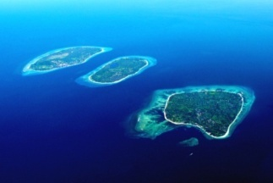
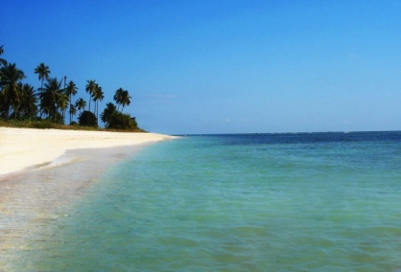
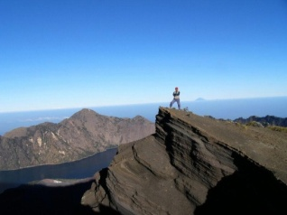
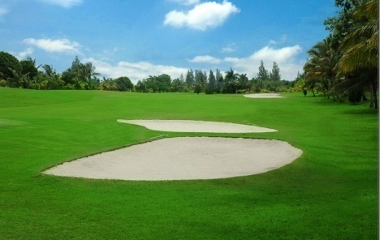
Anemalou Resort & Beach Club Sire Lombok
LOCATION
Location Anemalou Resort & Beach Club is located Lombok Sire. In front of the beauty of the white sand beach of Sire is the famous Gili Islands. What are the advantages of the location of this project?
So close to Gili Islands
White sand beach
Surrounded by Golf Course
Close to Tugu Hotel and Oberoi Hotel
Located in the bay so the waves are not dangerous to swim
Close to the harbour
Close to Mount Rinjani for you who like the challenge of climbing the mountain.

Slide 22
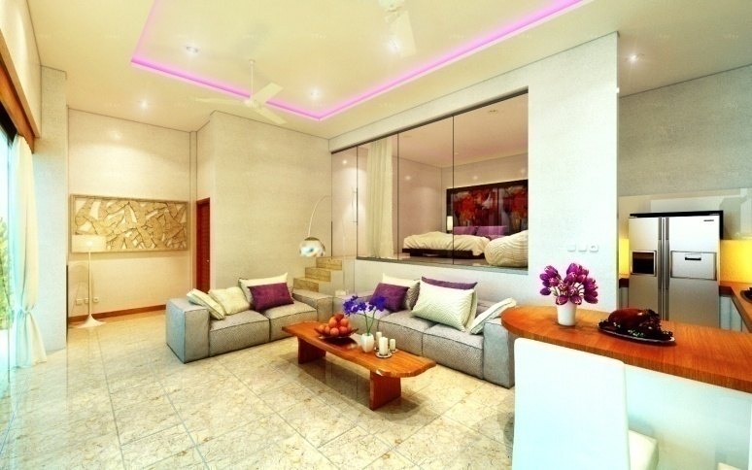
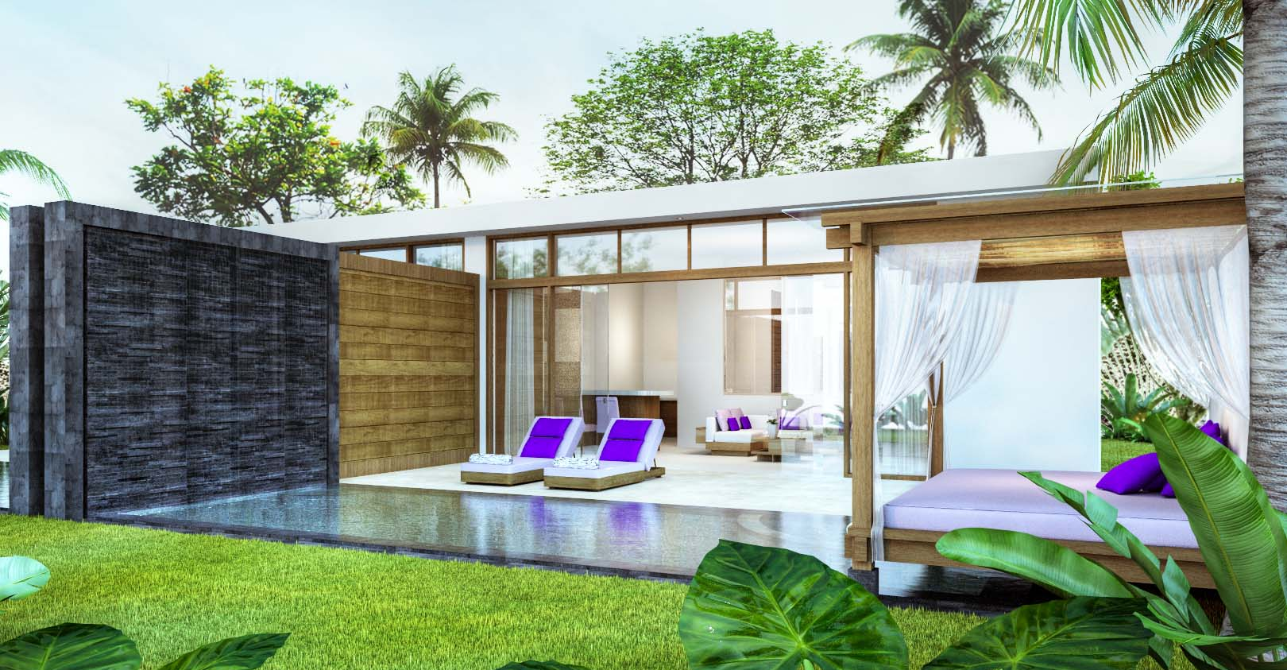
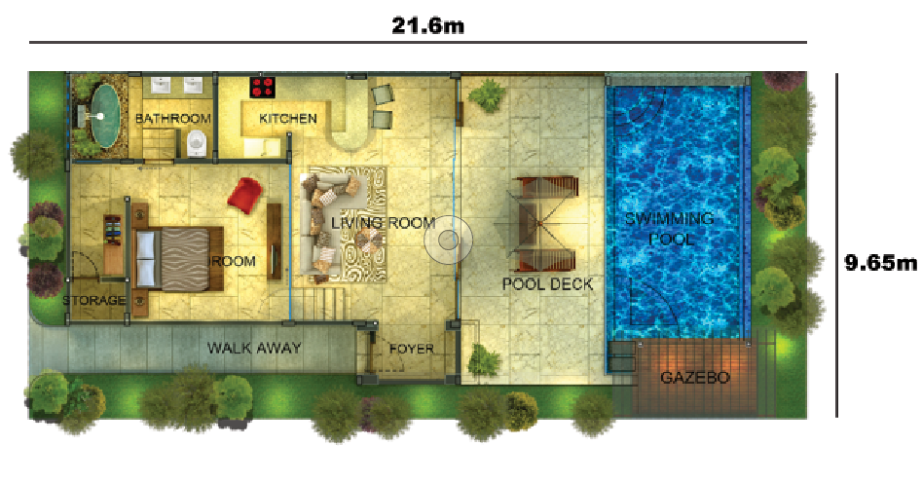
Anemalou Resort & Beach Club Sire Lombok
1 BEDROOM VILLA
Building area 143m²
Land area 208.44m²
Freehold
8m x 4m private pool
Master bedroom, en-suite bathroom

Slide 23
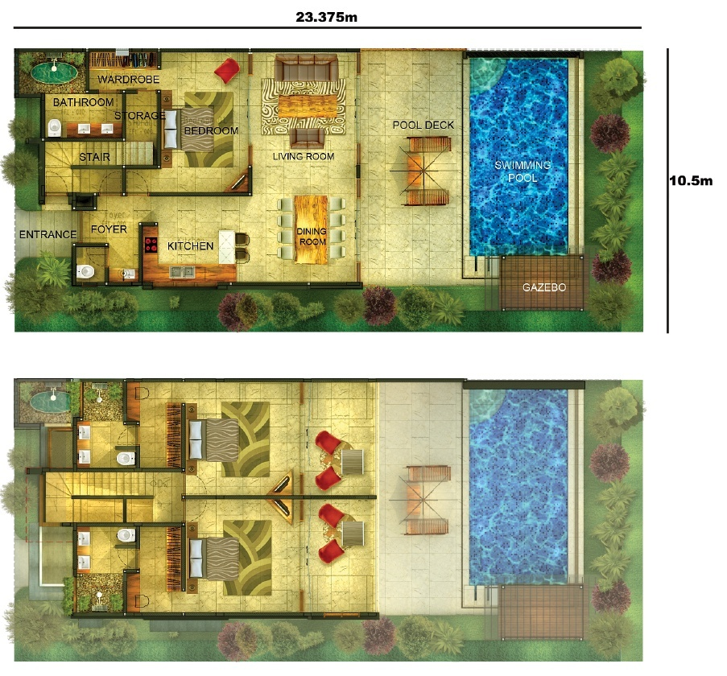
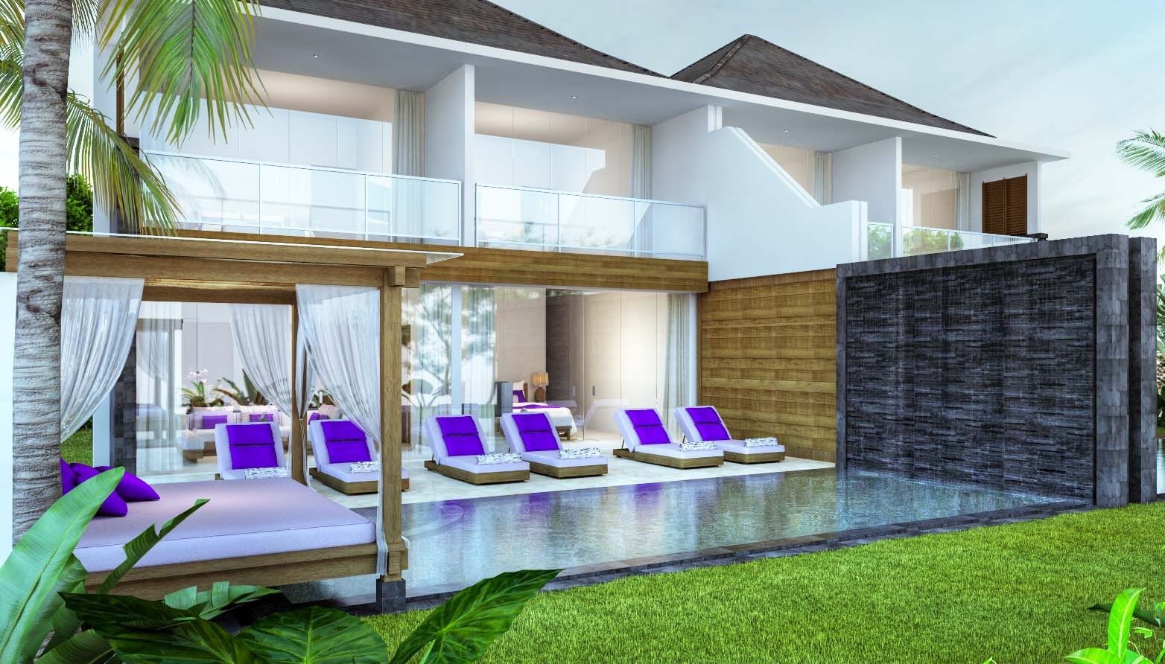
Anemalou Resort & Beach Club Sire Lombok
3 BEDROOM VILLA
Building area 230.03 m²
Land area 237.25 m²
Freehold
8,5m x 4,5m private pool
3 bedroom, en-suite bathroom, kitchen, dinning room

Slide 24
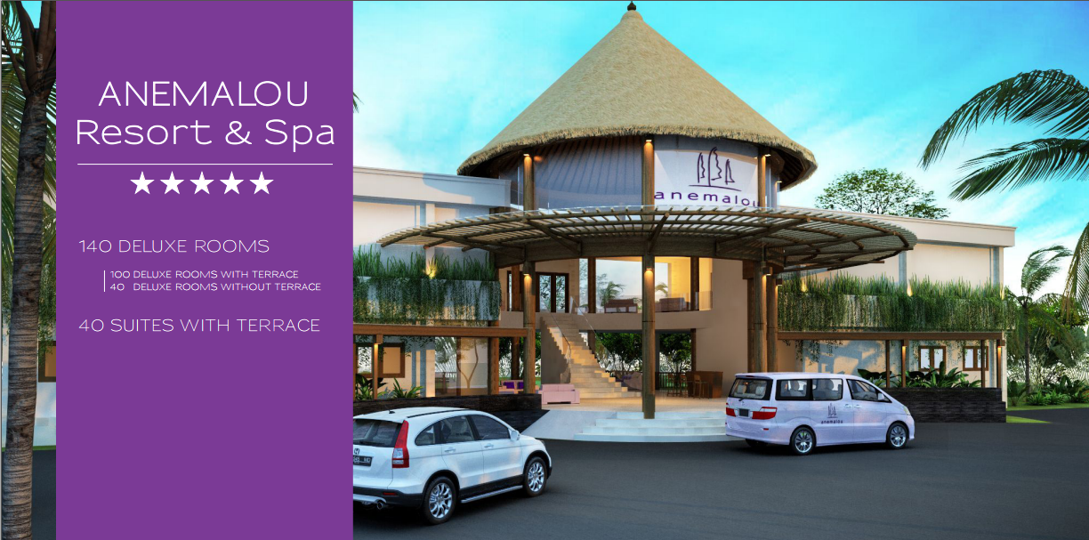
Anemalou Resort & Beach Club Sire Lombok

Slide 25
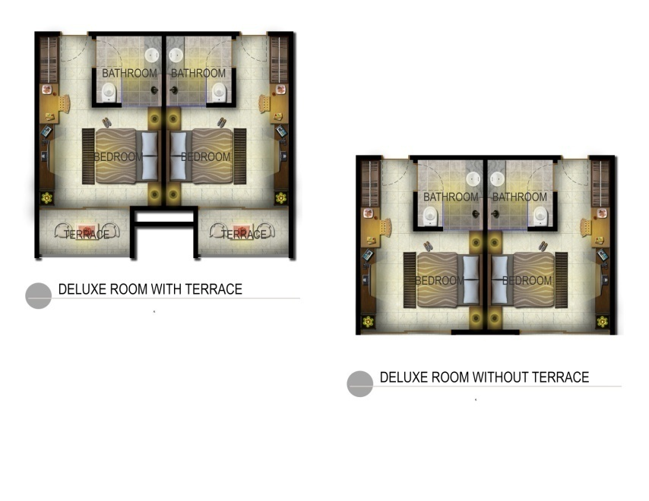
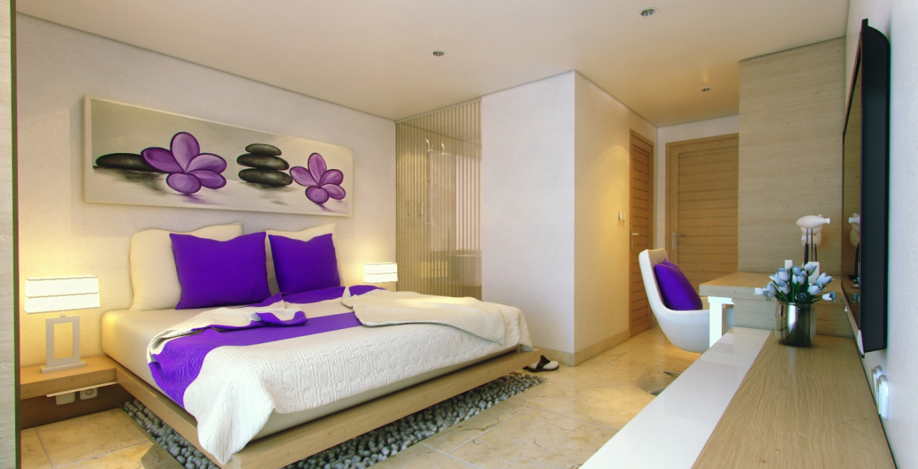
Anemalou Resort & Beach Club Sire Lombok
DELUXE ROOMS
Area 33m² / 28 m²
Freehold
2 options : with terrace or without terrace
Master bedroom, en-suite bathroom

Slide 26
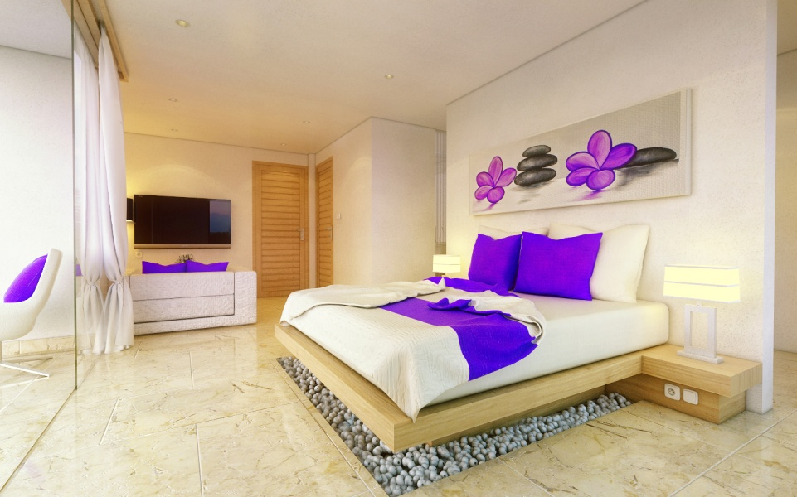
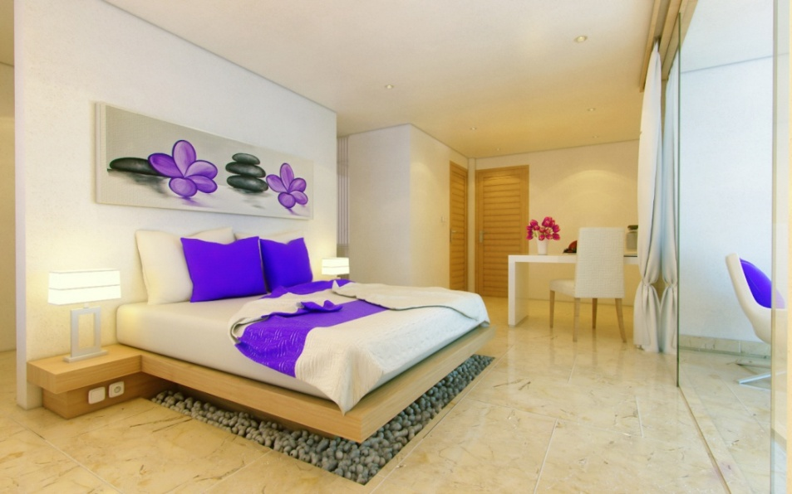
Anemalou Resort & Beach Club Sire Lombok
SUITES
Area 46m²
Freehold
Master bedroom, en-suite bathroom

Slide 28
MANAGEMENT
UNIT | MANAGEMENT SERVICE | MAINTENANCE SERVICE
1 BEDROOM VILLA | OPTIONAL | OPTIONAL (IF MANAGEMENT SERVICE IS NOT APPLIED)
3 BEDROOM VILLA | OPTIONAL | OPTIONAL (IF MANAGEMENT SERVICE IS NOT APPLIED)
DELUXE ROOMS | APPLIED | -
SUITES | APPLIED | -

Slide 29
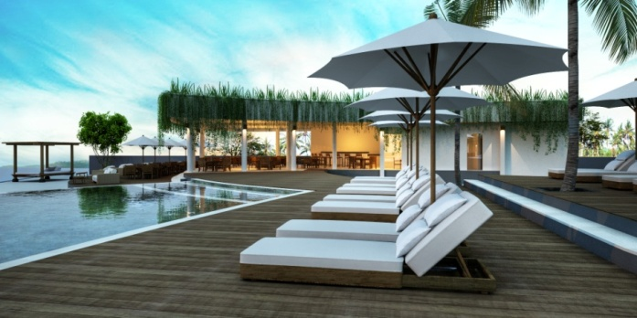
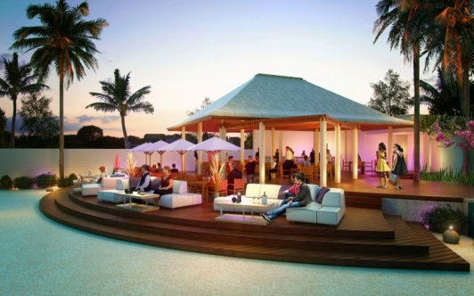
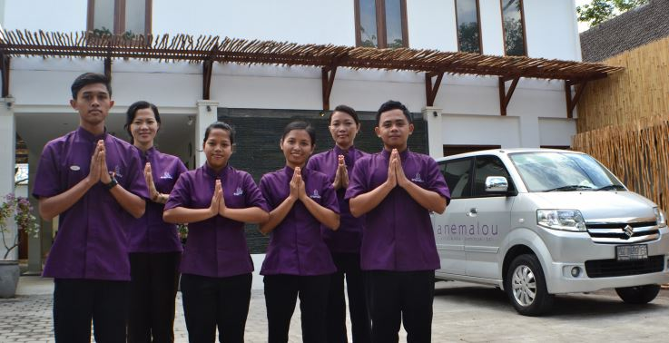
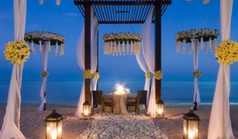
Anemalou Resort & Beach Club Sire Lombok
FACILITIES
Blue Room Beach Club
Mango Tree Restaurant
Spa
Service and Management
Wedding Chapel
Golf Course
Kids Club
Shuttle boat and helicopter service to Gili
Fast Boat to Bali

Slide 30
Anemalou Resort & Beach Club Sire Lombok
ROI
Calculation of ROI if you rent the property back to the management Anemalou Resort & Beach Club.

Slide 31
Pricelist
UNIT | BUILDING AREA | LAND AREA | VIEW | PRICE (USD)
Deluxe Room Type 1 Without Terrace | 28 m2 | - | Garden View | 72,000
Deluxe Room Type 1 Without Terrace | 28 m2 | - | Ocean View | 78,000
Deluxe Room Type 2 With Terrace | 33 m2 | - | Garden View | 84,000
Deluxe Room Type 2 With Terrace | 33 m2 | - | Ocean View | 91,200
Suite | 46 m2 | - | Garden View | 120,000
Suite | 46 m2 | - | Ocean View | 129,600
Villa 1 Bedroom with Pool & Jacuzzi | 143 m2 | 208.44 m2 | Ocean View | 429,000
Villa 3 Bedroom with Pool & Jacuzzi | 230.03 m2 | 237.25 m2 | Garden View | 752,400
Villa 3 Bedroom with Pool & Jacuzzi | 230.03 m2 | 237.25 m2 | Ocean View | 819,600

Slide 32
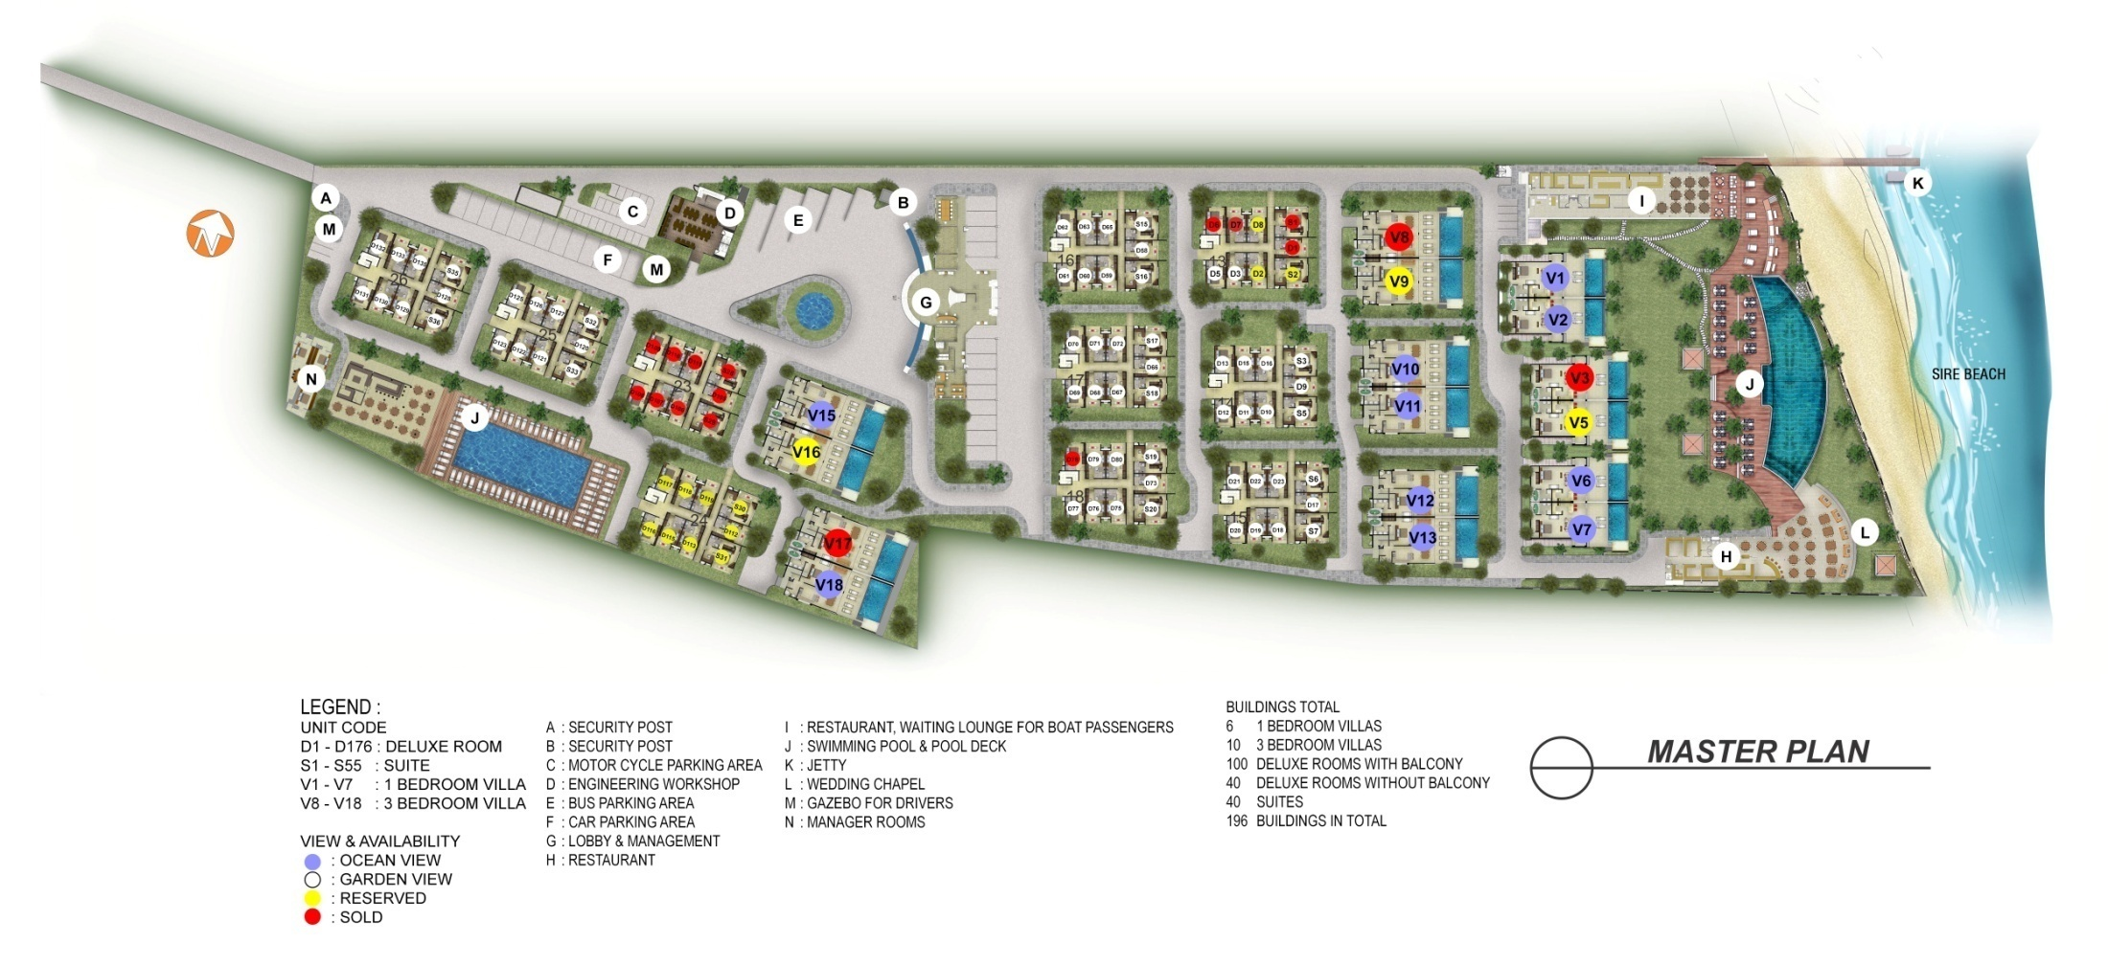
Unit Availability (Ground Floor)

Slide 33
Unit Availability (First Floor)

Slide 34
Anemalou Resort & Beach Club
Offers :
Residential / villa in a convenient location, beautiful white sand beaches, close to a variety of public facilities (malls, airports, ports)
Profitable investment
Property management experienced in Bali
Price per m² (front & white sand beach) ranging from USD 2,500 and will be 2X as much in 2-3 years. For comparison, in Bali Price per m2 USD 8,000 m, in Phuket per m2 USD 7,000
* Terms and conditions applied

Slide 35
Anemalou Resort & Beach Club
Offers :
Ownership options :
100% FREEHOLD with Average of ROI 15% yearly + capital gain 20%. Full income without guarantee average 35% yearly. Please note buyer has 3 months of period to change to option 2.
Buy back (like deposito) with guarantee 8% for 5 years, 10% for 10 years. In the end of the contract you will get 100% your initial investment.
All buyer will get 21 days free stay.
* Terms and conditions applied

Slide 36
INSURANCE
All buildings are covered by Zurich Insurance.

Slide 37
BOOKING FEE
Booking Fee : ONLY USD 2,000
The buyer needs to make a payment of $2000 booking fee as a sign of interest.
This will provide the buyer to travel from their country to visit the project
First day:
Buyer will come to Bali and stay overnight to view and have a good feeling about the Villa being built.
Second day:
Buyer will travel to Lombok with speed boat provided by Anemalou and stay overnight in a hotel provided by Anemalou partners.
Final day:
Buyer depart home to their country of origin.
Buyer will have 4 weeks time to complete their down payment after inspecting the location.
Booking Fee will be added to the 30% down payment if buyer agree to continue the purchase.

Slide 38
3 Payment Type
30 % Deposit + Installments 24 months without interest.
30% Deposit for order when building is finished 30%, down payment 30% when building is finished 60%, down payment 30% final delivery, balance 10%
Cash in Advance with 5% Discount

Slide 39
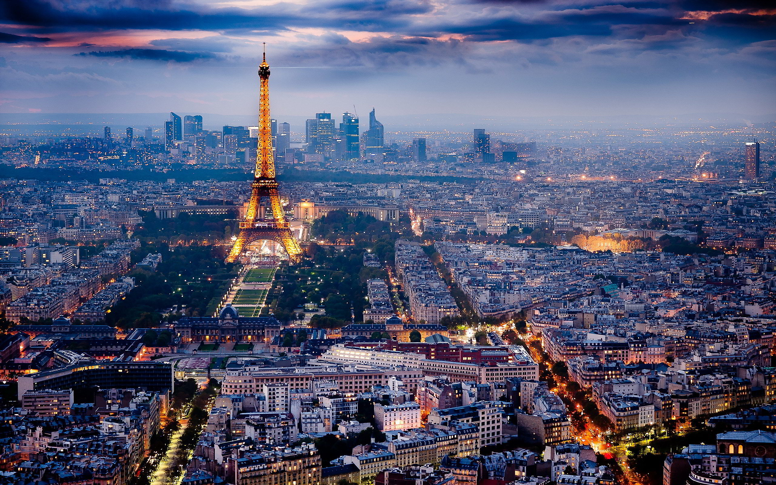
*Package stay at Anemalou Villas & Spa 3 Days 2 Nights &
Chance to win Free tickets to PARIS for 5 first person.
BOOKING FEE ONLY
USD 2,000
*term and condition applied

Slide 40
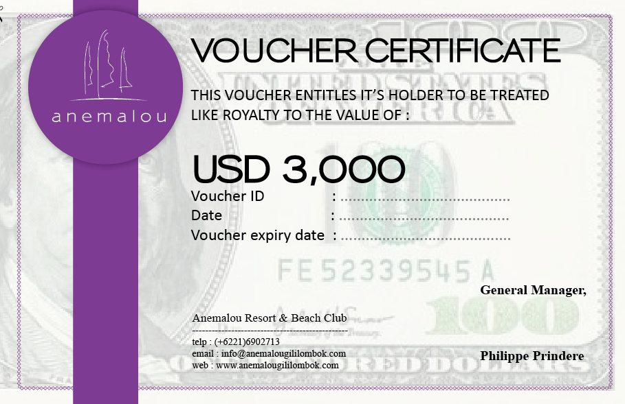
GIFT VOUCHER
Today for this event and only for the first 10 buyers, the developer give you 1 voucher USD3,000 discount
Who want to take this voucher? Please rise your hand!

Slide 41
THANK YOU
FOR YOUR ATTENTION
Bali Office
Anemalou Villas & Spa
Jl Kresna Legian, Bali
80361
☎ : 0361 755548
Jakarta Office
Ruko GC-HOOK Kawasan Green Lake Sunter
Jl. Danau Sunter Selatan Blok M
Sunter, Jakarta Utara
☎ : (+6221)6902713
P : (+6221)6902713
M : +6287 880017888
M : +6281 288016568
Website & Email
www.anemalougililombok.com
info@anemalougililombok.com

