Slide 1
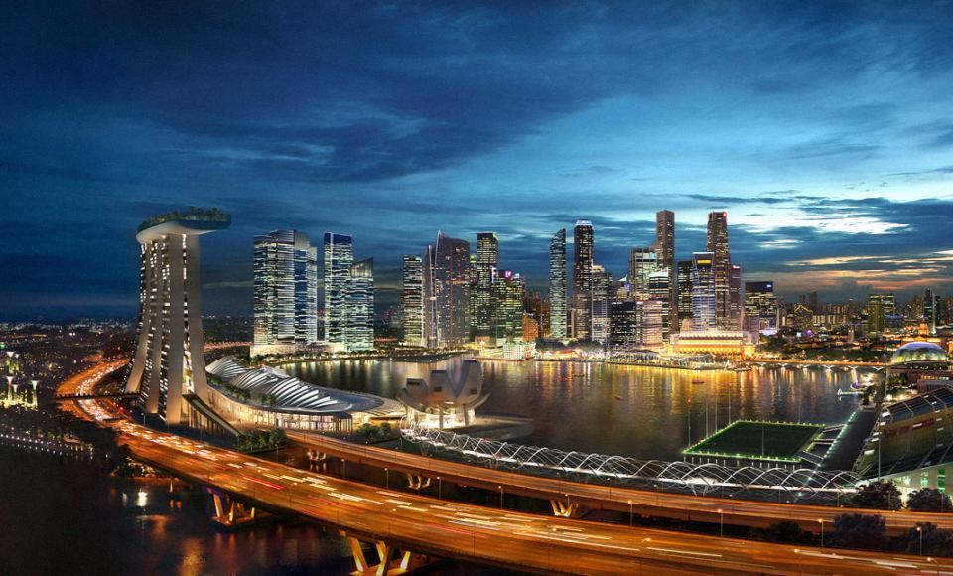
  新加坡的华丽转型
  与房地产市场动态

Slide 2

  新加坡 – 优越的地理位置
北京
上海
曼谷
新加坡
印尼
在6小时航程内
拥有32亿人口
Notes:
Combine slide 2 and 3 (use this map)
Show China, Indonesia (Bali, Jkt)
Bangkok (usually holiday here)

Slide 3
  新加坡基本数据一览
最新数据
国土面积 | 715.8平方公里
人均国内生产总值 | 315,250人民币
国内生产总值增长率 | 1.3%
通货膨胀率 | 2.5%
人口 | 540万
人口增长率 | 2.5%
家庭人数 | 3.5
失业率 | 2%
2013年预测
国内生产总值增长率 | 2.5 – 3.5%
人口增长率 | 1.6%
通货膨胀率 | 2-3%
失业率 | 2.1%
来源：新加坡统计局

Slide 4












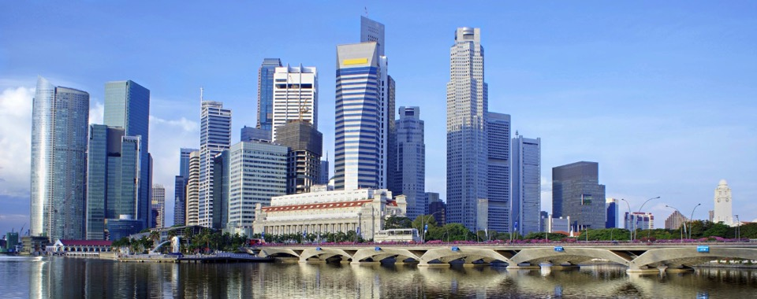
  国际金融中心 – 新加坡是世界第二个人民币离岸中心 40家私人银行管理着5000亿美元的私人资产

Slide 5
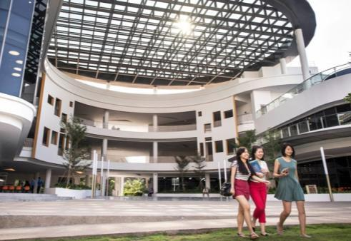












  新加坡的魅力
  国际教育之都

Slide 6
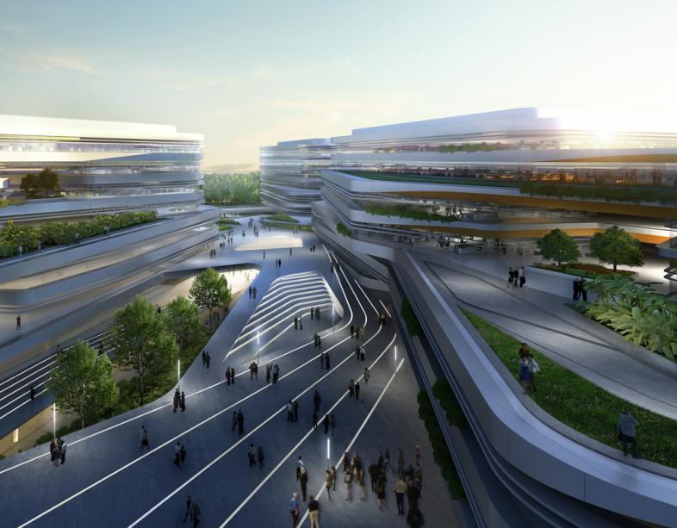






  新加坡的魅力
  国际教育之都
Notes:
High quality of education standards
Many international schools have been set up in Singapore because they see many foreign families coming to Singapore to live.

Slide 7
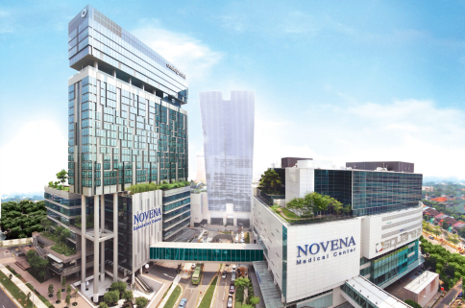
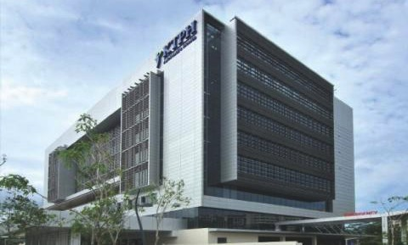
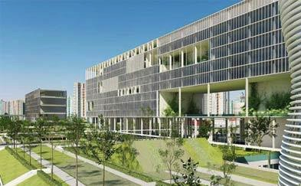
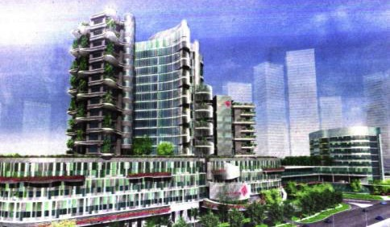
  新加坡的魅力
  亚洲医疗枢纽
诺维娜休闲医疗中心
邱德拔医院
黄廷芳医院 (在建 – 2014年竣工)
盛港医院 (在建 – 2018年竣工)

Slide 8
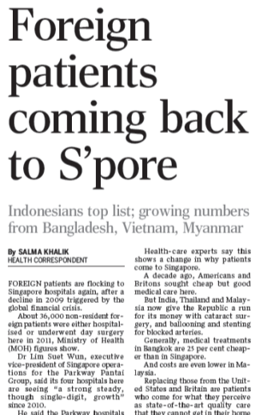
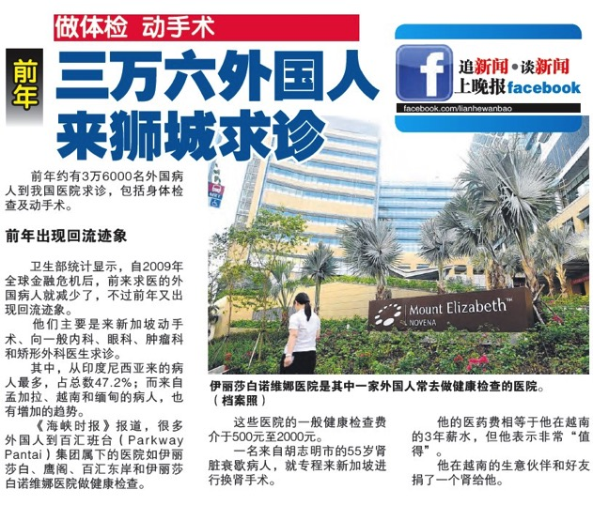
  新加坡的魅力
  亚洲医疗枢纽
2012: 100万医疗旅游者, 25亿美元医疗旅游收入
外国就医者青睐
新加坡
来源: 海峡时报, 2013年2月18日

Slide 9
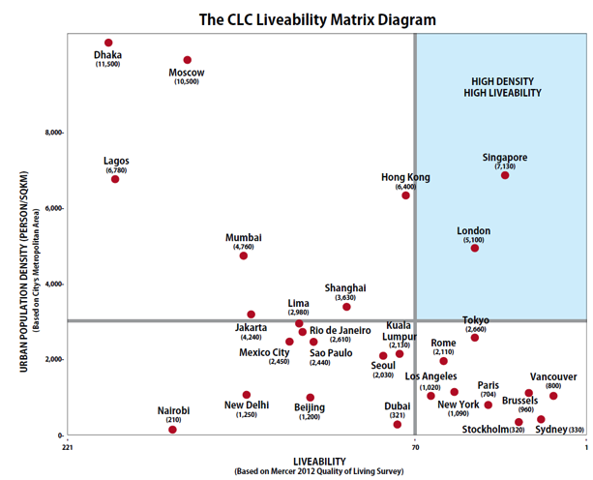

  亚洲最宜居城市
“新加坡是亚洲最适宜生活、工作与娱乐的城市”
宜居城市矩阵
美世2012年世界城市 生活质量排名
排名 | 城市
1 | 新加坡
2 | 东京
3 | 神户
4 | 横滨
5 | 大阪
高密度
高宜居性
新加坡
来源:
美世， 2012世界城市生活质量排行
城市土地学会, 宜居城市研究中心, 高密度城市的10项宜居原则
Notes:
EIU criteria: Economy, Environmental Friendliness, Quality of Life, Safety and Governance
Original list: http://www.mercer.com/qualityoflivingpr#city-rankings

Slide 10
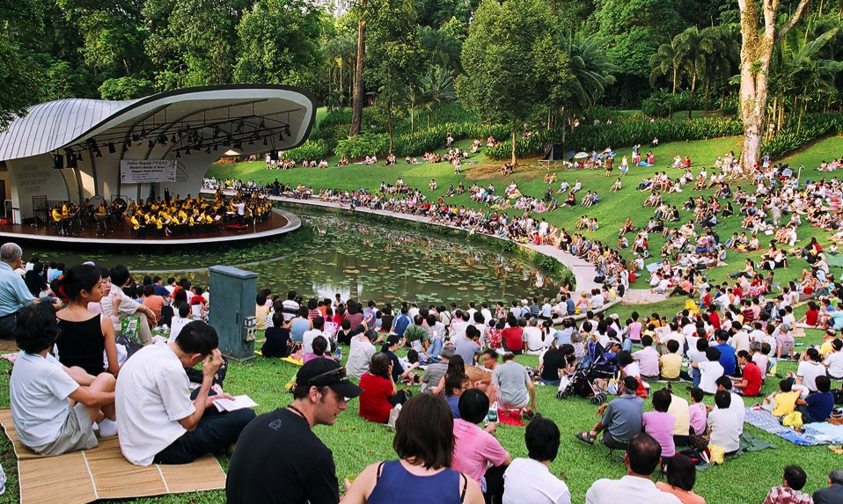
  亚洲最宜居城市
  城市花园
2016年，植物园的面积将增加9.8公顷，总面积将达近74公顷

Slide 11
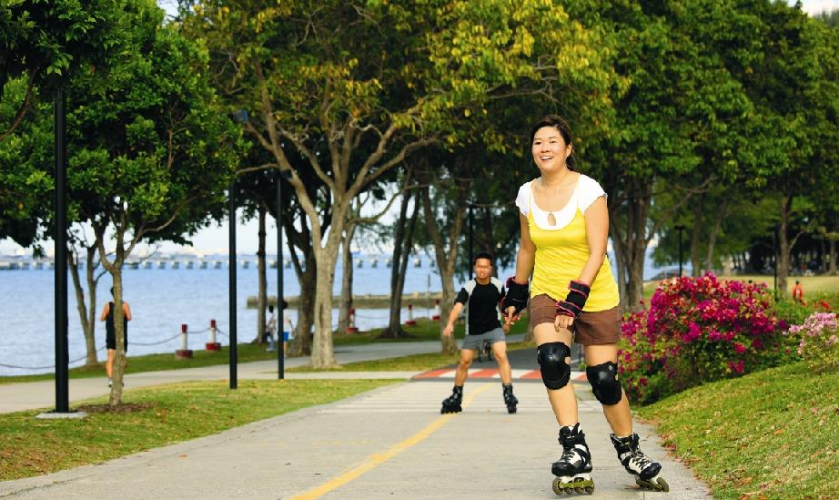
  亚洲最宜居城市
  城市花园
东海岸公园，新加坡最受欢迎的滨海休闲区

Slide 12
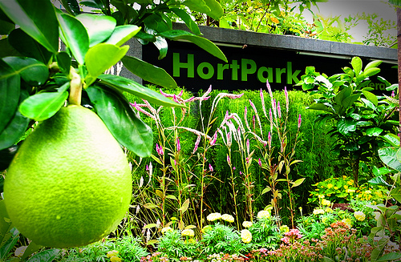
  亚洲最宜居城市
  城市花园
园艺园林
Notes:
CAPTION ON HORT PARK

Slide 13
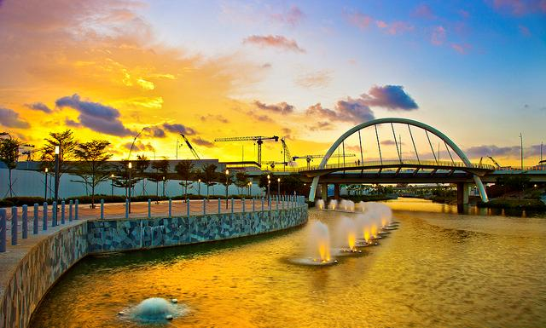
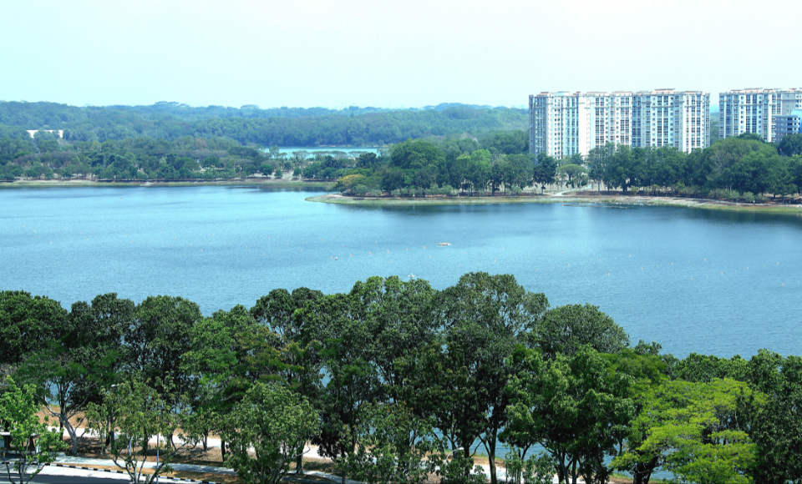

  亚洲最宜居城市
  广阔的水道网络
2030年前建成900公顷的蓄水池和100公里的水道
勿洛蓄水池
榜鹅水道
Notes:
The ABC Waters Programme captures the vision for Singapore’s catchments and waterways, which will be active, dynamic, full of life and activities. (“Active”), aesthetically pleasing (“Beautiful”) and in good water quality (“Clean”) while achieving the “Active” and “Beautiful” components. Under the 2008 Master Plan, Punggol will be the first waterfront HDB estate.
There are 20 successful ABC Waters projects around the island, and four more to be completed in the next 2 years. In the next 10 to 15 years, over 100 ABC Waters proposals have been identified for implementation. These are guided by an island-wide ABC Waters Master Plan unveiled in 2007.

Slide 14
  国际大都市
  蓬勃发展的旅游业
访客人数 (百万)
“国家计划在接下来的5年内斥资9.05亿元进一步发展旅游业”
- 《海峡时报》, 2012年9月29日
收入 (10亿新币)
来源: 新加坡旅游局
Notes:
14

Slide 15
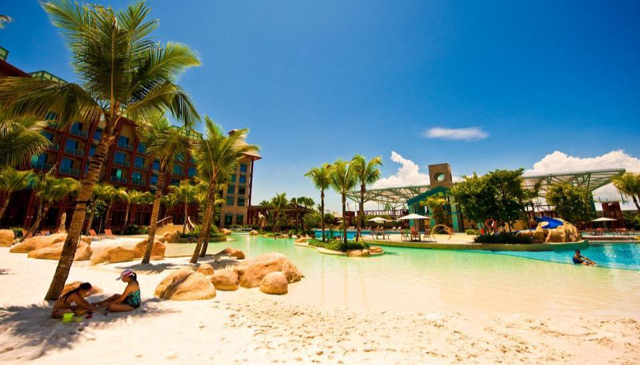
  国际大都市
  圣淘沙
新加坡首个综合娱乐城——圣淘沙名胜世界，
及世界最大的海洋馆——海洋生物园皆坐落于圣淘沙岛

Slide 16

  国际大都市
  游河探险乐园
亚洲首个以河流为主题的野生公园，于2013年4月开幕

Slide 17
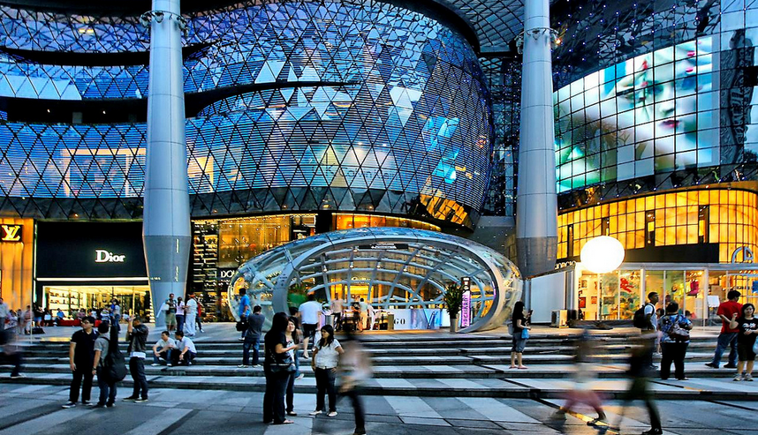
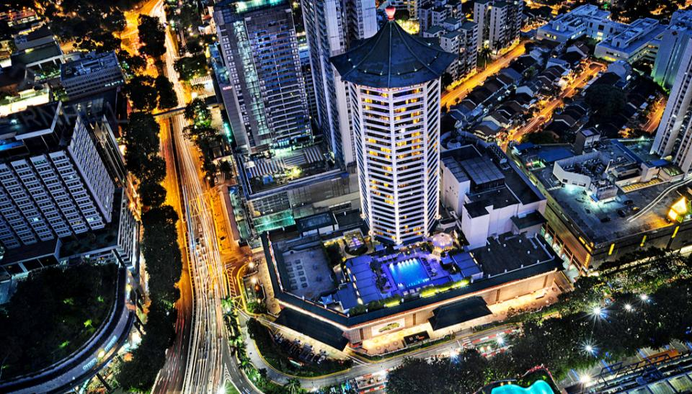
  国际大都市
  乌节路
2.2公里长的乌节路是新加坡的购物与娱乐枢纽

Slide 18
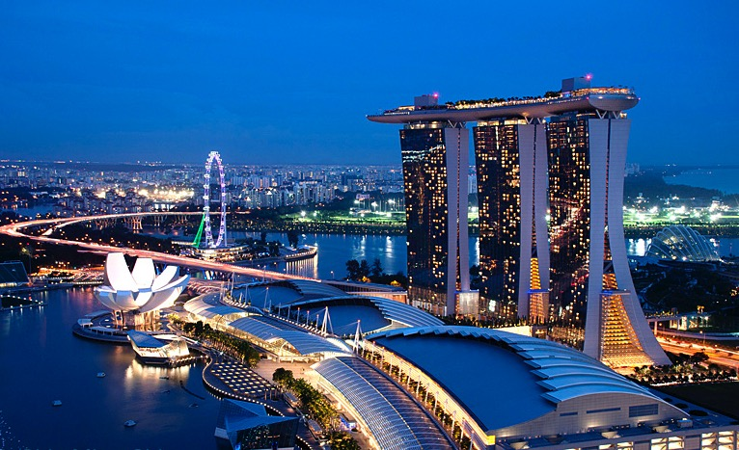
  国际大都市
  滨海湾新市中心
朝气蓬勃，活力四射的生活、工作与娱乐之地

Slide 19
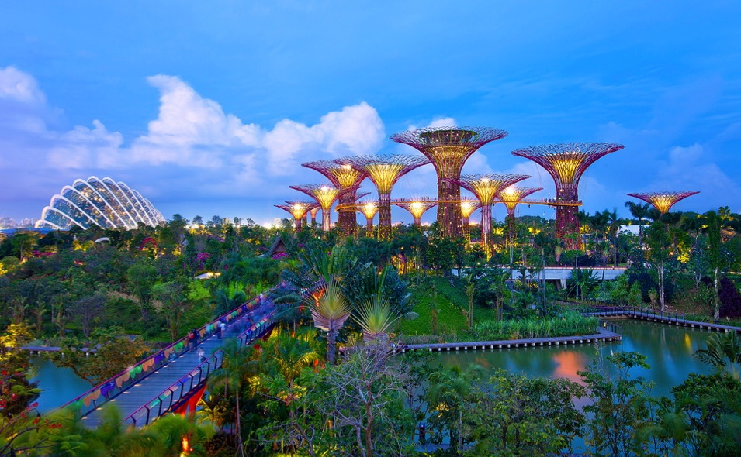
  国际大都市
  滨海湾花园
占地101公顷，包含三座世界级大型滨水花园

Slide 20
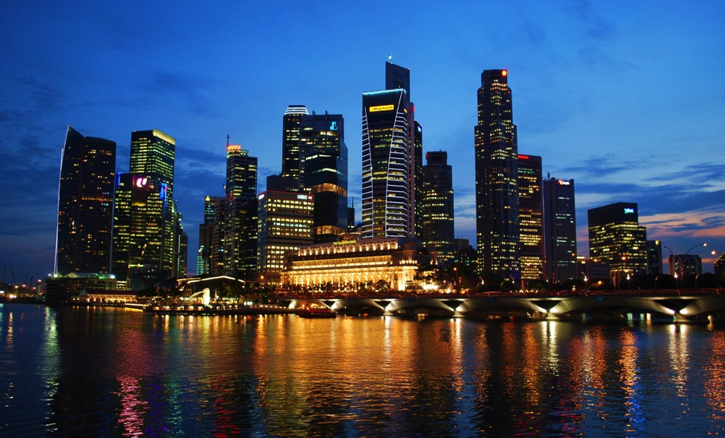
  国际大都市
  中央商务区
中央商务区包含核心金融与商务区

Slide 21
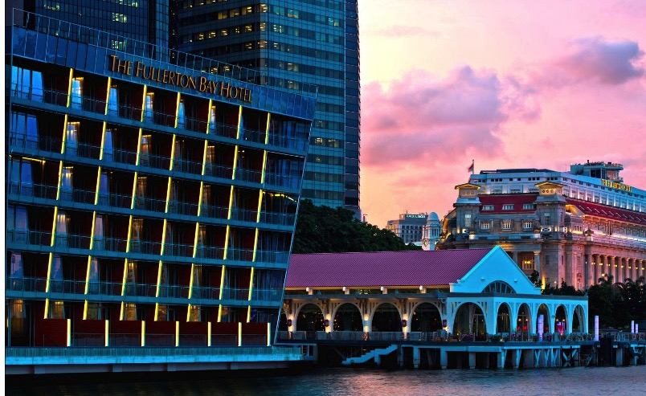
  国际大都市
  富丽敦天地
富丽敦天地是全新的滨水高档就餐、购物与娱乐场所

Slide 22
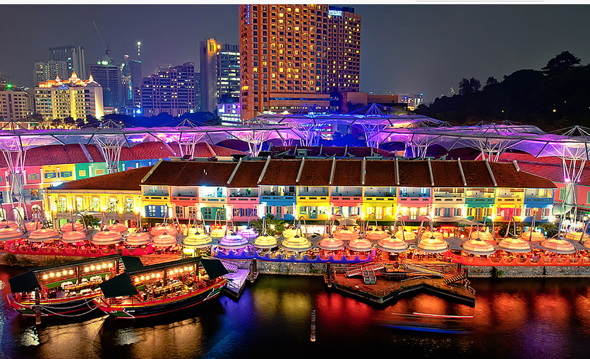
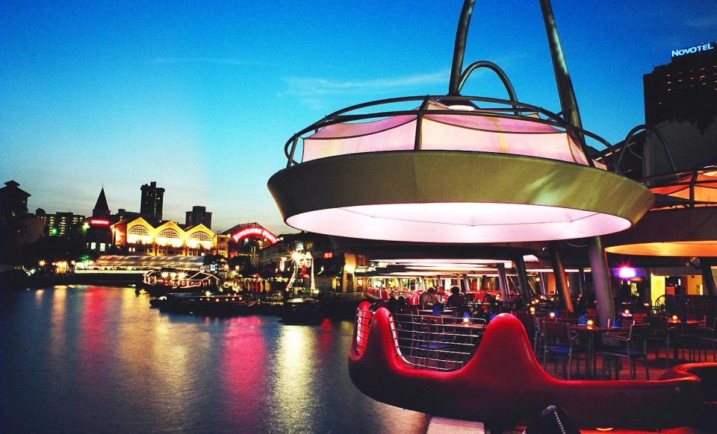
  国际大都市
  克拉码头
新加坡河畔的餐饮与娱乐热点

Slide 23
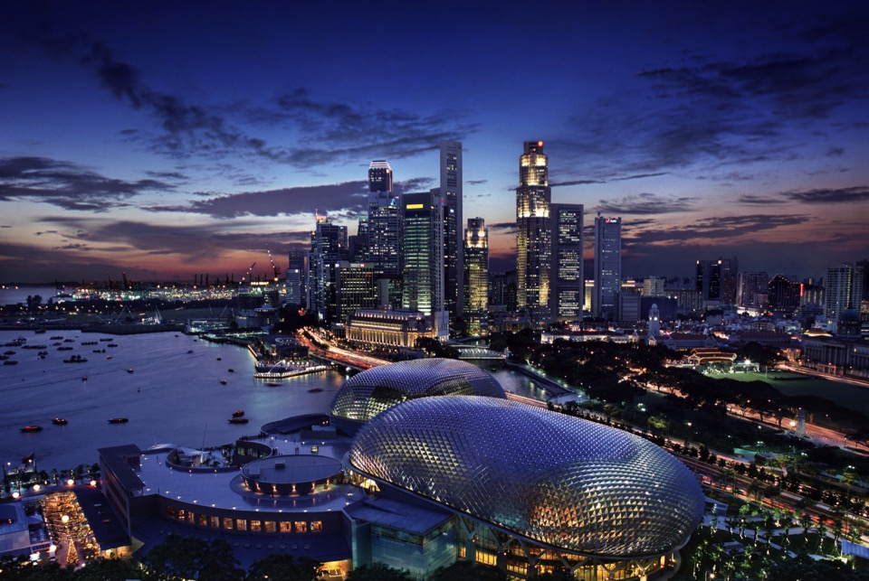
新加坡的华丽转型

Slide 24

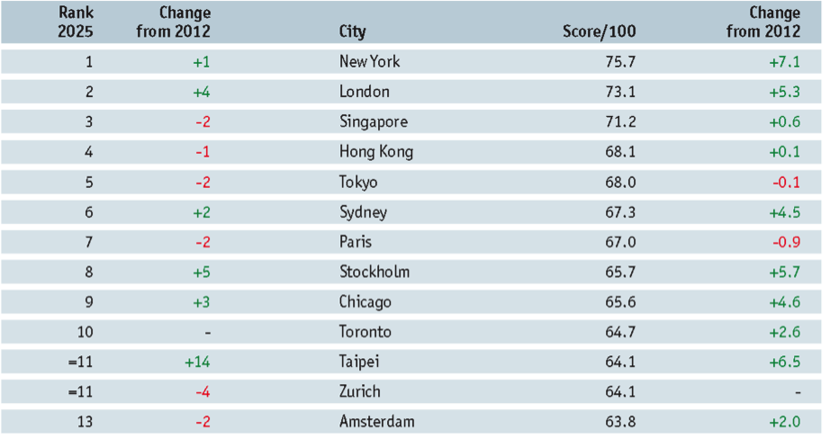
  新加坡的华丽转型
  2025年最具竞争力的亚洲城市
来源: 经济学人智库
Notes:
Singapore ranks 3rd overall in the Index and is the first-placed Asian city.
Singapore scores particularly well in terms of its physical capital (ranked joint first overall), financial maturity (joint first), and environment and natural hazards (joint first) and global appeal (3rd).
None of this is surprising given the city’s efficient transport system, lean bureaucracy, safe and clean environment, and its increasingly high international reputation. The city’s focus on improving the quality of education allowed it to jump 27 places to 10th in the human capital category in 2025.

Slide 25
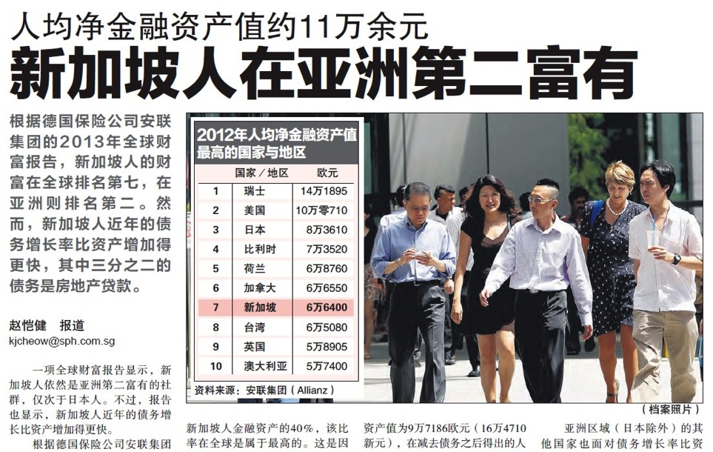
  新加坡的华丽转型
来源: 联合早报, 2013年10月3日

Slide 26
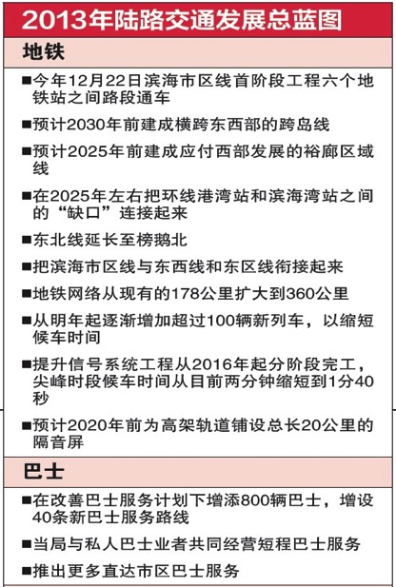
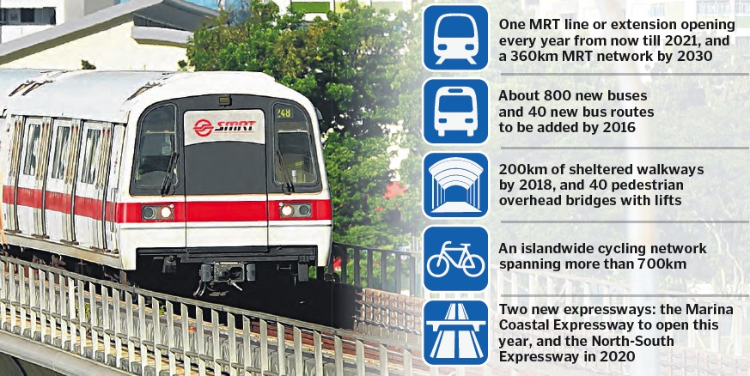
  新加坡的华丽转型
  陆路交通发展总蓝图
Notes:
Singapore will also have a comprehensive rail network and the vision is to bring 8 in 10 by 2030.
The Eastern Region Line will serve the residential estates of Tanjong Rhu, Marine Parade, Siglap, Bedok South and Upper East Coast, link them to east Changi.
The Tuas West Extension is an extension of the East-West Line from Joo Koon Station, consisting of 4 stations namely Tuas, Tuas Crescent, Tuas West and Tuas Link which will improve the MRT connectivity in the Tuas area. When operational in 2016, Tuas West Extension is expected to serve about 100,000 commuters daily.
The North-South Line that currently ends at Marina Bay station will be extended 1km southwards to serve the upcoming developments in the southern Marina Bay area, such as the new cruise terminal in Marina South.
In real estate, “location, location, location” is said to be the most important thing that determines a property’s value.
Homes near MRT will always fetch a premium, especially when car prices are rising.

Slide 27
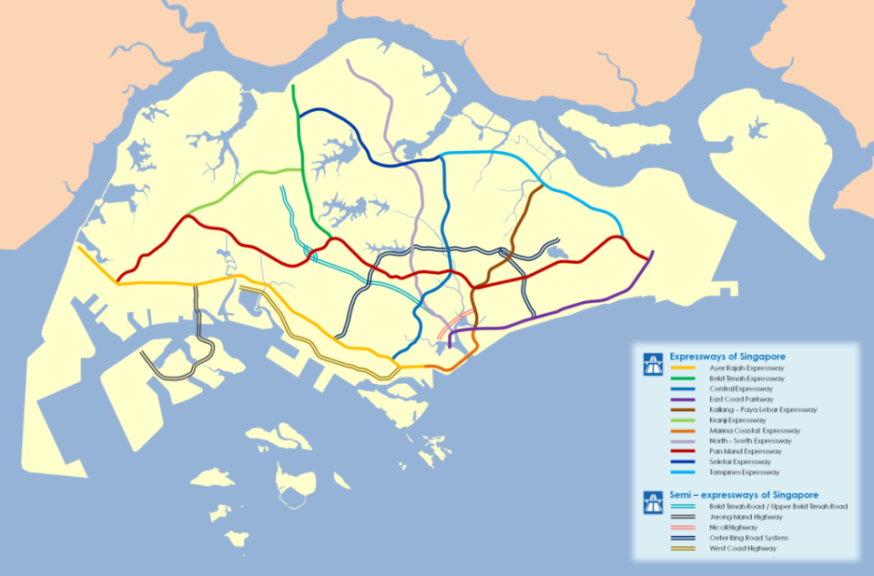
  新加坡的华丽转型
  完善的公路交通网络
SLE
南北快速公路
(2020年通车)
BKE
KJE
KPE
TPE
PIE
AYE
ECP
CTE
滨海快速公路
(2013年通车)
Notes:
11 expressways, 5 semi-expressways
Completed recently is the 12-m Kallang-Paya Lebar Expressway (KPE), which features a 9km stretch that is entirely underground. Other major road projects are the 5km Marina Coastal Expressway and 21km North-South Expressway.

Slide 28
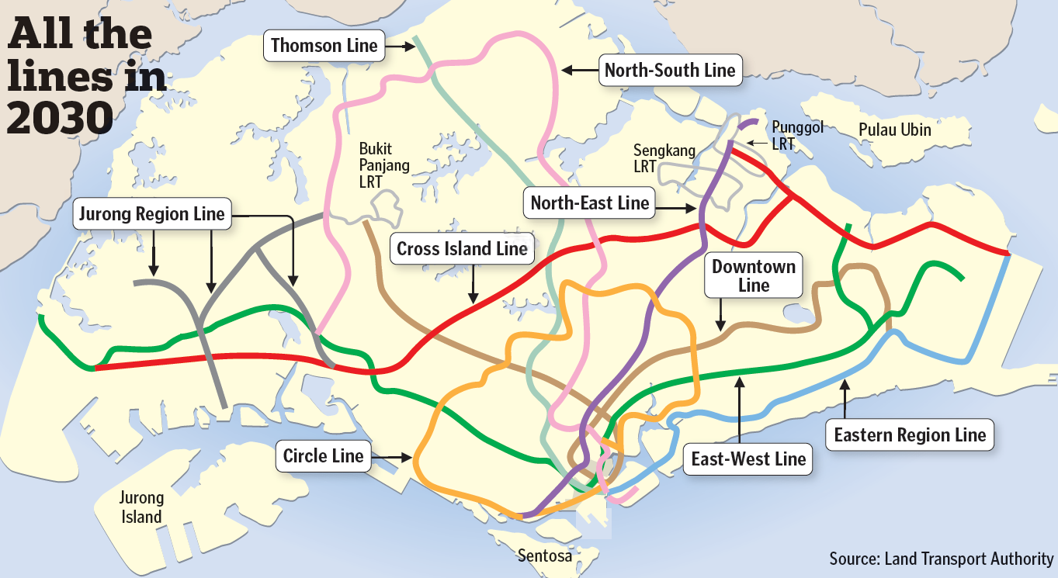
  新加坡的华丽转型
  完善的轨道交通网络
斥资600亿新元使地铁网络覆盖面增加一倍
– 每个家庭将在600米范围内拥有地铁站
2025年开通
2021年开通
2025年开通
2030年开通
2025年开通
2020年开通
2025年开通
第六阶段
来源：新加坡陆路交通管理局
Notes:
The Singapore Rail network is being extended to serve the new developments coming on stream and to cater to population growth. The government has allocated $60 billion to double the rail network.
The Eastern Region Line will serve the residential restates of Tanjong Rhu, Marine Parade, Siglap, Bedok South and Upper East Coast and link them to Changi in the east.
From the heart of Marina Bay, a new MRT line, the Thomson Line, will travel northwards, through the Central Business District and up through Ang Mo Kio all the way to Woodlands connecting estates such as Sin Ming, Kebun Baru, Thomson and Kim Seng which do not now have a direct MRT link.
The Tuas West Extension is an extension of the East-West Line from Joo Koon Station, consisting of a 7.5km of twin tracked viaduct and four aboveground stations. The four stations* - Tuas, Tuas Crescent, Tuas West and Tuas Link will improve the MRT connectivity in the Tuas area. Commuters working in the Jurong and Tuas industrial estates will enjoy significantly better public transport connectivity and enhanced accessibility. When operational in 2016, Tuas West Extension is expected to serve about 100,000 commuters daily.
The North-South line that currently ends at the Marina Bay station will be extended 1km southwards to serve the upcoming developments in the southern Marina Bay area, such as the new cruise terminal in Marina South.

Slide 29
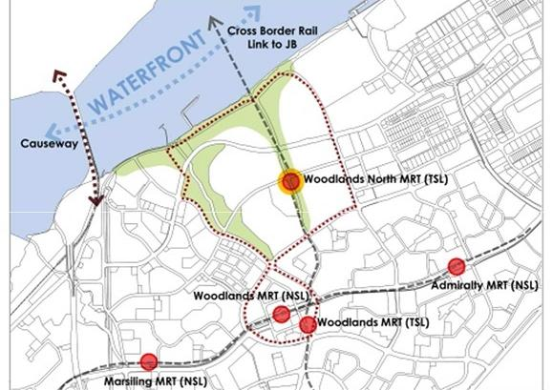
  新加坡的华丽转型
  增强与马来西亚的连通性
兀兰北地铁站作为兴建中的汤申地铁线的一部分，同时也将成为连接新山市铁路的转换站
Notes:
Bringing New Life to Woodlands – TODAY, 25 Feb 2013

Slide 30
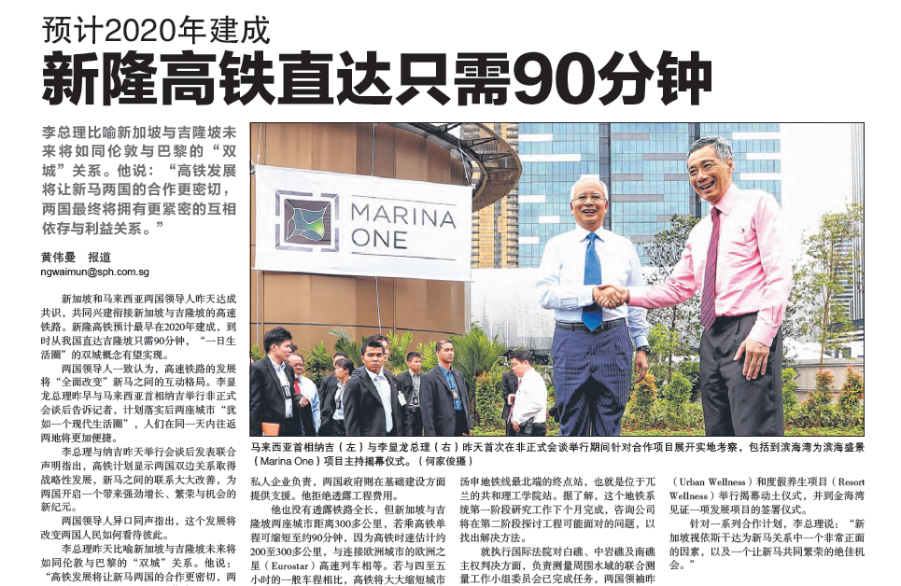
  新加坡的华丽转型
  增强与马来西亚的连通性
Source: The Straits Times, 21 Feb 2013
Source: The Straits Times, 20 Feb 2013

Slide 31
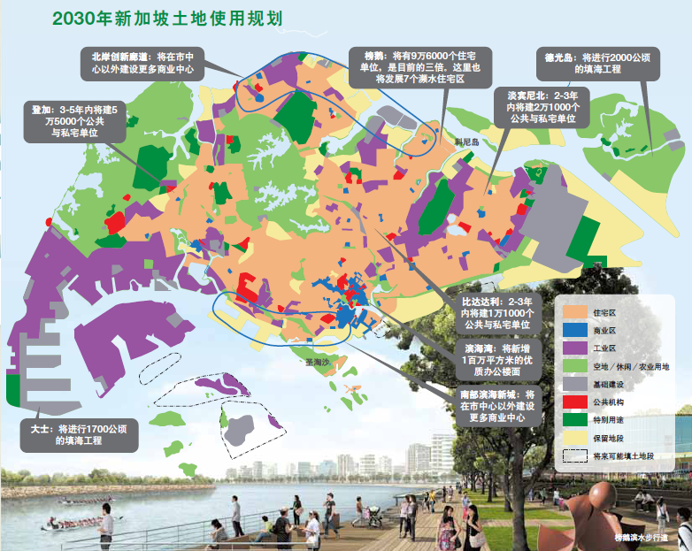
  新加坡的华丽转型
690万人口

Slide 32
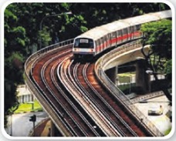
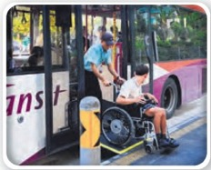
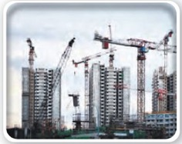

  新加坡的华丽转型
  确保高质量的生活环境
基础设施建设 2020年前完成
全面提升基础设施建设以满足2020年580万至600万人口的需要，
同时缓解目前的设施压力
地铁
2021年前增建100公
里地铁线
70%家庭在10分钟步
程内有地铁站
巴士
未来5年新增800辆
巴士
为残疾人士提供更
大便利
住宅
在2016年前新增
110,000套公共住宅和90,000套私人住宅
对市中心区进行翻新改造
医疗
新增4100个医院病
床
更多服务于老年人
的医疗设施

Slide 33
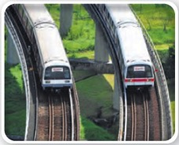
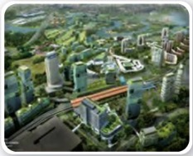
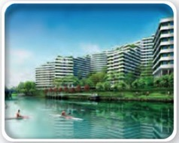
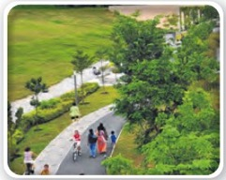
  新加坡的华丽转型
  确保高质量的生活环境
基础设施建设 2030年前完成
进行长远规划，以使2030年时的650万至690万人享有优质生活，
并创造未来的发展空间
地铁
地铁线路增加一倍至360公里
80%家庭在10分钟步程内有地铁站
建成两条新地铁线及三条延长线
住宅
为700,000套住宅规划土地
建设富有活力及独特魅力的住宅区
住家附近的工作与娱乐
在住宅区附近创造更多就业机会
在住家附近增添更多绿化与休闲设施
更优质的环境
将新加坡打造成“城市花园”
建设更多公园与绿色空间

Slide 34
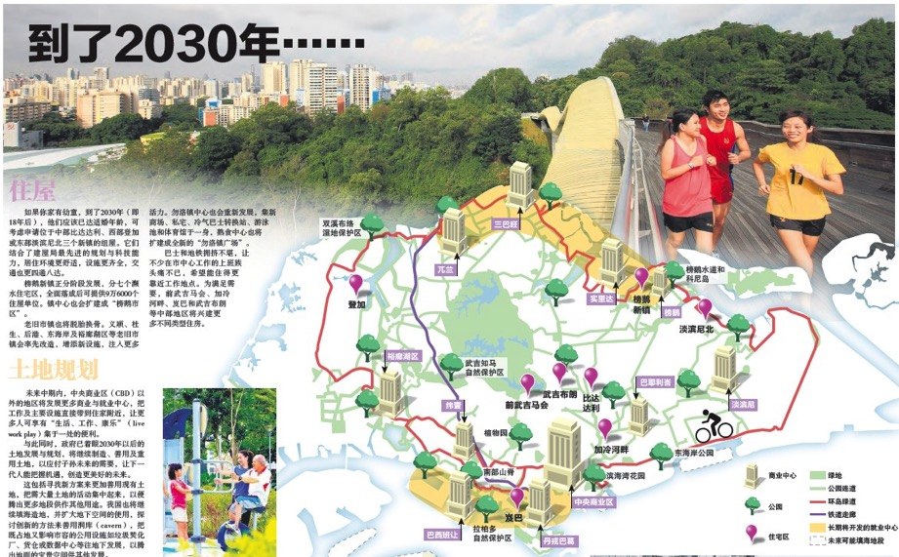
  新加坡的华丽转型
  2030年，85%的家庭将在400米内拥有公园
来源: 联合早报, 2013年2月3日

Slide 35
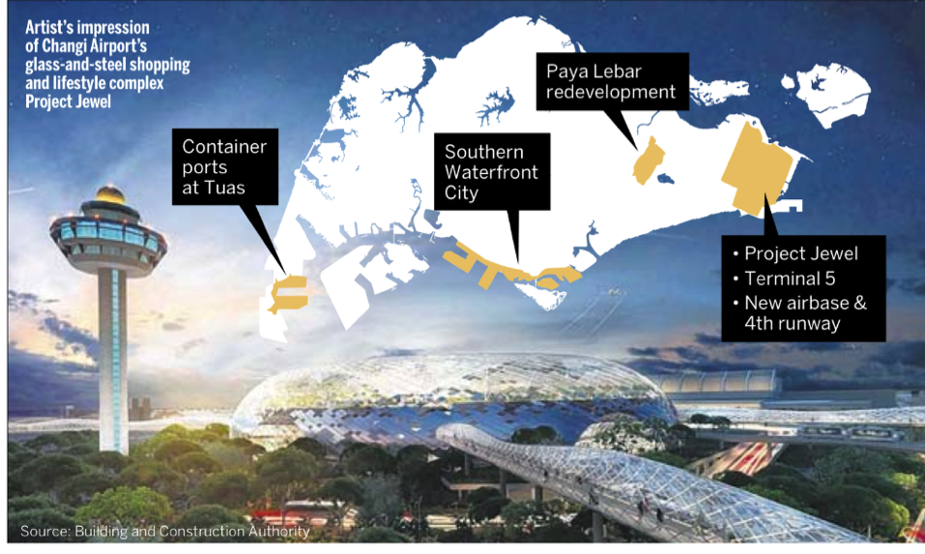
  新加坡的华丽转型
  未来的大型发展项目
巴耶利峇商业枢纽
大士集装箱码头
南部滨海新城
宝石
5号航站楼
新空军基地和第4条跑道
来源: 海峡时报, 2013年11月11日

Slide 36
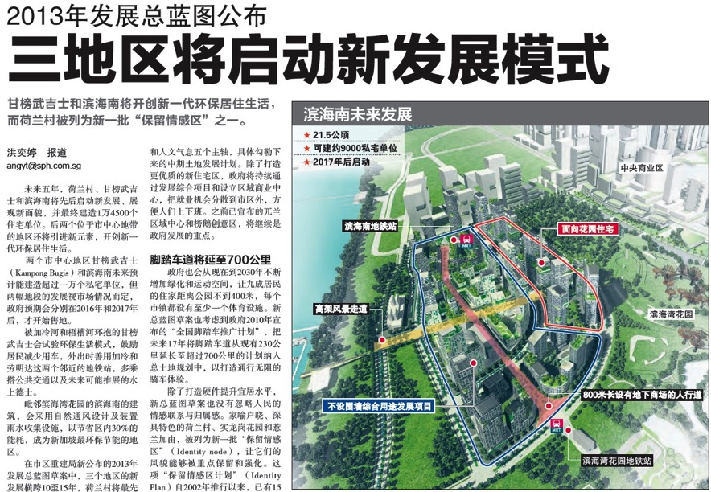
  新加坡的华丽转型
  2013年发展总蓝图
未来五年，荷兰村、甘榜武吉士和滨海南将先后启动新发展、展现新面貌，并最终建造1万4500个住宅单位。
来源: 联合早报, 2013年11月20日

Slide 37
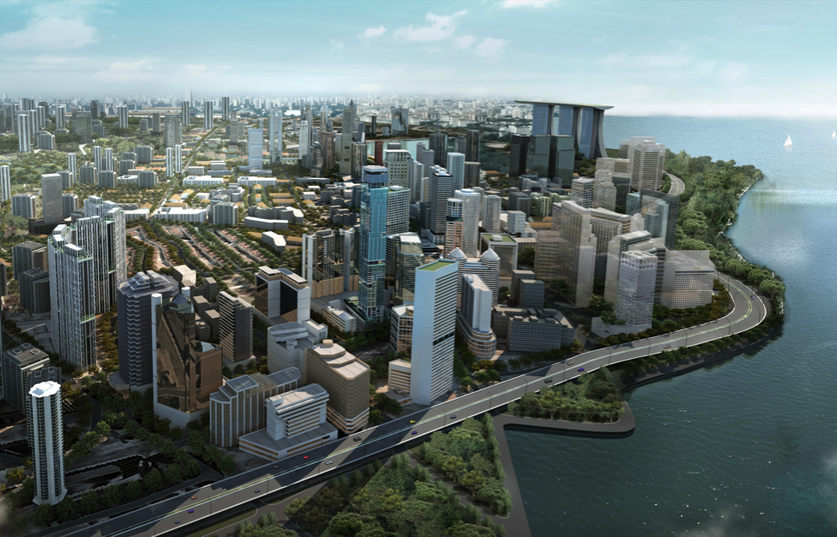
  新经济增长区
  未来的丹戎巴葛滨海新城
丹戎巴葛的集装箱码头将在2027年迁往大士，将为滨海新城建设提供从珊顿道延伸至巴西班让的大片黄金地段，其面积是滨海湾的2.5倍。
Notes:
Completion of pipeline projects will further enhance business and tourism growth and in turn keep driving real estate value.
Reference notes
International Cruise Terminal
Singapore’s International Cruise Terminal is designed by Bermello, Ajamil and Partners and RSP Architects Planners and Engineers and the construction of the terminal is slated for completion by the end of 2011. The design of this two-berth facility with its distinctive rooftop depicts a modern interpretation of low rolling waves and will leave a lasting impression on cruise guests and other visitors to Singapore.
http://www.traveldailynews.com/pages/show_page/40276-Singapore%60s-new-international-cruise-terminal-to-have-passenger-boarding-bridges
Gardens By the Bay
Three distinctive waterfront gardens in the heart of Marina Bay that will define Singapore as the world's premier tropical garden city.
http://www.gardensbythebay.org.sg/?p=section&sub=article&articlegrppk=31
Singapore-Malaysia land swap
Khazanah is investing in Singapore: Six parcels of land (four parcels in Marina South and two in Ophir-Rochor) were vested in M+S Pte Ltd, a joint venture company owned 60% by Malaysia’s Khazanah and 40% by Singapore's Temasek with a GDV of over S$11 bn (RM27 bn), in exchange for the railway land.
Marina South
The land parcels in Marina South are 'white' multi-use sites, of which at least 60% must be developed into office space. The rest is for 'activity-generating' developments, such as retail outlets.
The Marina South sites have a total gross floor area of 3.67 mn sq ft. Work on the Marina South project will likely start in June 2012; with construction likely to be completed by mid-2016, the project will likely comprise two office towers and ancillary retail as well as two blocks of residential towers.
Ophir-Rochor
At the Ophir-Rochor parcels, a minimum 40% of the land has been zoned for office use and 15% for hotel and hotel-related development. CapitaLand, together with UEM Land, was appointed for the Ophir-Rochor parcels which will likely boast office, residential, hotel and retail space, totalling a gross floor area of over 1.72 mn sq ft.
http://doc.research-and-analytics.csfb.com/docView?language=ENG&source=ulg&format=PDF&document_id=901531361&serialid=r1OrIiVm%2BDlSxoIKvYQJLKUnPFwBhvVoLnfNHTRGwmQ%3D
Guocoland + Malaysian pension fund Employees Provident Fund (EPF) to develop the city’s tallest apartment.
- The company said it has sold a 20 percent stake (estimated to be worth S$640 million) to the EPF for the upcoming S$3.2 billion mixed-use development above Tanjong Pagar MRT station
http://www.kelvintan.myweb.sg/mw-property-news/2011/6/30576/guocoland-epf-to-jointly-develop-s-pore-s-tallest-
http://www.iproperty.com.sg/news/3295/The-Jewel-of-Tanjong-Pagar

Slide 38
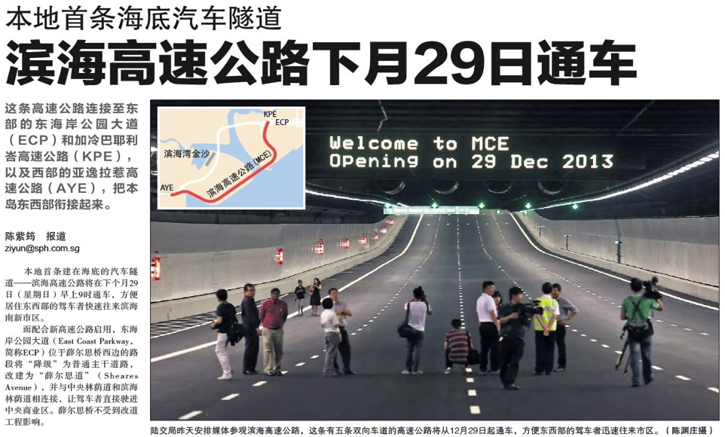
  新经济增长区
  滨海高速公路
来源：联合早报 2013年11月14日
Notes:
Singapore will also have a comprehensive rail network and the vision is to bring 8 in 10 by 2030.
The Eastern Region Line will serve the residential estates of Tanjong Rhu, Marine Parade, Siglap, Bedok South and Upper East Coast, link them to east Changi.
The Tuas West Extension is an extension of the East-West Line from Joo Koon Station, consisting of 4 stations namely Tuas, Tuas Crescent, Tuas West and Tuas Link which will improve the MRT connectivity in the Tuas area. When operational in 2016, Tuas West Extension is expected to serve about 100,000 commuters daily.
The North-South Line that currently ends at Marina Bay station will be extended 1km southwards to serve the upcoming developments in the southern Marina Bay area, such as the new cruise terminal in Marina South.
In real estate, “location, location, location” is said to be the most important thing that determines a property’s value.
Homes near MRT will always fetch a premium, especially when car prices are rising.

Slide 39
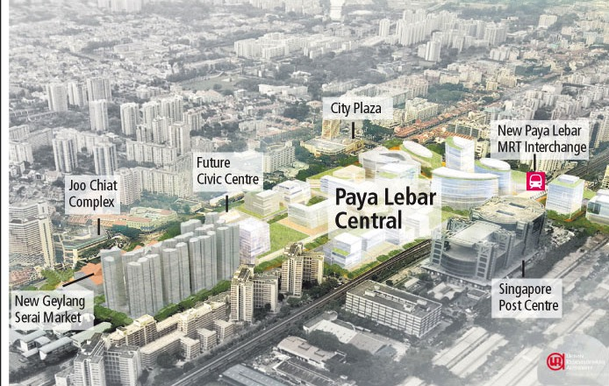
  新经济增长区
  巴耶利峇中心
拥有540万平方英尺商业楼面的商业枢纽
Notes:
39

Slide 40
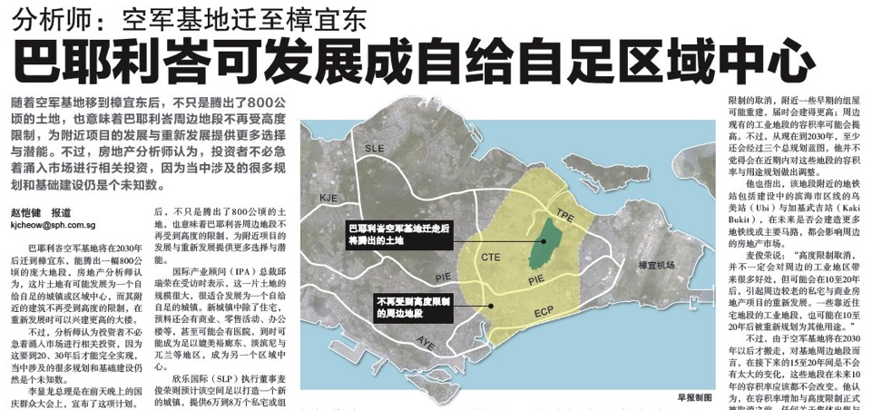
  2013国庆群众大会宣布
  巴耶利峇空军基地将在2030年迁至樟宜
巴耶利峇空军基地迁至樟宜后, 将腾出800公顷的土地用于重新发展, 对周围的建筑高度限制也将解除
来源：联合早报, 2013年8月20日
Notes:
Paya Lebar Airbase will be moved to Changi. This will free up a big plot of land (bigger than Bishan or Ang Mo Kio) for new homes, offices, factories, parks and more in Paya Lebar.
Relocating the airbase will remove height restrictions on a large area around Paya Lebar, and allow eastern Singapore to be redeveloped in new and exciting ways.
40

Slide 41
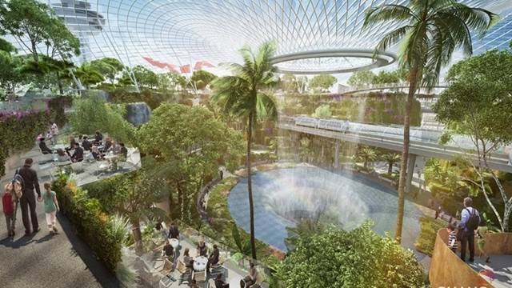

  2013国庆群众大会宣布
  宝石(Jewel)
樟宜机场将兴建代号为“宝石”的综合项目、
两座新的航站楼和第四条跑道
Notes:
Changi Airport will be upgraded with a new complex codenamed Project Jewel, two new terminals and a fourth runway
Project Jewel will expand Terminal 1 – shops, restaurants, indoor garden - will be built outside Terminal 1
Terminal 5 will have a 3rd runway and double Changi Airport current capacity – by mid 2020s
New RSAF airbase and a fourth runway will be built at Changi East
41

Slide 42


  2013国庆群众大会宣布
  宝石(Jewel)
1号航站楼将扩建，5号航站楼将兴建第三条跑道并在
2020年前把樟宜机场的客容量增加一倍
即将建成
- 新的4号航站楼 (2017年前)
- 1号航站楼外名为“宝石”的综合项目(2018年前)
斥资
约12.8亿新元兴建4号航站楼和相关设施
客容量
从 每年660万增至850万
未来10年的发展
- 新的5号航站楼
- 第三条跑道
客容量
增至每年1320万
Source: The Straits Times, The Business Times, 20 Aug 2013
Notes:
Changi Airport will be upgraded with a new complex codenamed Project Jewel, two new terminals and a fourth runway
Project Jewel will expand Terminal 1 – shops, restaurants, indoor garden - will be built outside Terminal 1
Terminal 5 will have a 3rd runway and double Changi Airport current capacity – by mid 2020s
New RSAF airbase and a fourth runway will be built at Changi East
42

Slide 43

  新经济增长区
  诺维娜健康城
诺维娜将在2030年前建成新加坡最大的医疗保健枢纽，齐聚各大公共与私人医疗机构，并相互连接，共同构成诺维娜健康城。
建筑面积将从25万平米扩展至60万平米（约85个足球场的面积），并新增一系列医疗与服务设施
Notes:
Health City Novena – the mega health-care complex will be ready by 2030 to cater to the growing number of day surgery patients.

Slide 44
  新经济增长区
  马来西亚、新加坡土地交换协议
滨海南, 奥菲亚—梧槽白色地段
Notes:
44

Slide 45

  新经济增长区
  裕廊与湖畔区
290公顷的土地与20公顷的水面将兴建全新的 零售、餐饮、娱乐、办公、酒店等项目
Notes:
45

Slide 46

  新经济增长区
  榜鹅21
东北部的21世纪滨海新城

Slide 47

  新经济增长区
  榜鹅21

Slide 48



  新经济增长区
  北部沿海创新经济开发区
Seletar
北部区域将变成全新
商业区
Punggol
Source: The Straits Times, 2 Feb 2013
Notes:
CAPTION ON PICTURE

Slide 49

  新经济增长区
  兀兰区域中心
70公顷的兀兰北部沿海地区将转变为集商业、住宅与休闲于一体的滨海区域中心。30公顷的兀兰市镇中心将成为适宜步行的区域商业枢纽。
Woodlands North Coast
Woodlands Central
Source: Urban Redevelopment Authority, The Straits Times, 25 Feb 2013

Slide 50

  新经济增长区
  垂直社区
将“垂直社区”概念发展至全新高度
兀兰地区正在规划发展“垂直社区”，将在2017年前把住宅、商场、诊所、幼儿园、养老服务、餐饮中心、花园和公共空间全部整合在同一建筑内
一条通往海军部地铁站的室内连道将让这一区域的日常生活和交通更为便捷
Source: The Straits Times, 15 Aug 2013
Notes:
There is another major advantage to Vertical Kampung. Due to the scarcity of prime land in any estate; Integrating various facilities in one place and building up, more agencies can share that prime location – again, to the
benefit of residents.
The above is an artist’s impression of the Woodlands integrated building, which will bring together homes, shops, clinics and public spaces under one roof by 2017.

Slide 51

  新经济增长区
  新加坡工业中心
新加坡航运中心迁至大士
来源：The Business Times, 2012年10月2日
Notes:
Tuas Biomedical Park
World-class manufacturing hub for the biomedical industry
312 ha land for pharmaceutical and biologics manufacturing
Home to many global biomedical companies such as GlaxoSmithKline, Novartis, Pfizer and Roche
Over S$6bil worth of investment
Offshore Marine Centre - Purpose-built facility that offers an integrated suite of marine terminal-related services targeting the offshore and marine industry. 13-hectare development in Tuas South Avenue 8
Integrated New Yard Facility
Singapore’s first integrated yard facility
206-hectare development located at Tuas View Extension
Built in 3 phases. The 73.3-hectare S$750 mil Phase I New Yard Development is scheduled to be completed by end 2013
Private Investments in Tuas:
Biotech giant Amgen is building a $200 mil manufacturing facility in Tuas Biomedical Park, which will be completed in 2015.
Asia Pacific Breweries is spending S$20 mil to expand its 1.3 mil hectolitre brewery in Tuas.
Novartis is building $608m biotech plant in Tuas
Baby food giant Mead Johnson Nutrition is investing S$412 mil in a manufacturing and research facility in Tuas – expected to be completed in mid 2014.

Slide 52

  新经济增长区
  樟宜南
全新的商业园、购物中心与商务酒店
樟宜商业园
Notes:
The International Cruise Terminal is a new cruise terminal which will be located at Marina South next to the Marina South Pier. Work began in June 2008 and it is scheduled to be completed by end 2011.
The facility, costing S$500 million, comes as global demand for the cruise market is estimated to hit 27 million passengers by 2020 - a two-fold growth within a decade.
By 2015, Singapore hopes the new terminal can host the world's largest Oasis-class cruise ships and attract 1.6 million cruise passengers. The terminal can handle 6,800 passengers at any one time and will double Singapore's berth capacity.
52

Slide 53

  2013国庆群众大会宣布
  海外媒体报道

Slide 54

新加坡房地产市场驱动力

Slide 55

  新加坡政府的房地产政策
住宅拥有率= 90%
政府的目的:
“可持续发展的住宅市场，房价的增幅应与经济基本面保持一致…，促使市场持续稳定地发展
政府的工具:
公共住宅供给
土地出售
印花税及其他税费
Notes:
82% own HDB flats (50 Years Of Public Housing In Singapore. (2011). Retrieved from http://www.earoph.info/pdf/2011papers/2011-PAPER7.pdf)

Slide 56

  人口增长
许文远：2030年前新增700,000套住宅
为满足增长的人口需求，在2030年前需新增700,000套住宅
– 比现有的120万套住宅的一半还多
来源：海峡时报，2013年1月30日

Slide 57


  增长的人口
2030年，新加坡将达到:
2-3%的国内生产总值年增长率
1-2%的生产力增长率
700,000 套新增住宅
360公里地铁线
Notes:
1.25 million Singaporeans in professional, manager, engineer and technician category (PMET).
With more Singaporeans in higher skilled jobs, incomes will increase and affordability will be enhanced.

Slide 58
  人口与住宅供给
人口增长速度超过住宅存量增长
截至2013年3季度，
私宅存量共
286,006套
Mil
6.5-6.9
5.8-6
来源: 新加坡统计局，市区重建局
Notes:
58
Household Stock:
2010: 1,156,775
2011: 1,182,870
2012: 1,198,192
http://www.singaporepropertycycle.com.sg/market-trends/singapore-property-price-index-and-housing-stock/
2012 Q4: 277,620 available units
2013 Q1: 279,824 available units

Slide 59
  强劲的基本面因素
人均国民收入
房产价格指数
房产价格指数
人均国民收入
来源: 新加坡建屋局，市区重建局
Notes:
Per Capita GNI not updated in Singstat yet (last check 15 Jan)

Slide 60



  收入增长，房价可承受
若比照收入增幅，新加坡住宅价格
更趋合理
新加坡与美国的房价收入比
来源: 海峡时报, 2013年6月20日

Slide 61
  强劲的基本面因素
组屋转售价奠定了大众私宅市场的价格基础
重建局指数
组屋指数
全球金融危机
降温措施
重建局价格指数
组屋转售指数
来源: 新加坡建屋局，市区重建局
Notes:
Private property prices are supported by HDB prices. Government’s objective is to maintain the value of HDB prices and this was also reiterated in PM Lee’s National Day Rally.
Prices continue to rise despite the cooling measures. Noticed the price index is plateauing, and this is what the government wants – property prices.

Slide 62
  住宅租金指数与空置率
租金空置率保持稳定
租金指数
新加坡拥有53万永久居民及149万外籍流动人口
空置率%
来源: 市区重建局
注：所有住宅类型，不包括执行共管公寓
Notes:
In 2008 during the financial crisis, foreigners did not return home. Vacancy rate remains stable.
62

Slide 63

  强劲的需求
  新加坡住宅年销售量
1
2009/9:取消IAS贷款配套
2
2010/2: 卖方印花税, 80% 贷款顶限
2012年10月
40-60% 贷款顶限
最长35年贷款期
2013年1月
调低贷款额度, 调高额外买方印花税
6
7
Units
3
4
2011年1月
卖方印花税；60% 贷款顶限
2011年12月
额外买方印花税
8
2013年6月
总债务偿还比率
5
来源: 市区重建局
注：所有住宅类型，不包括执行共管公寓
Notes:
Sept 2009 – remove IAS
Feb 2010 – ssd, ltv 80%
Aug 2010 – ltv 70%, ssd, min cash payment

Slide 64
  强劲的需求
  月住宅销售量
2012年10月
40-60% 贷款顶限
最长35年贷款期
7
2013年1月
调低贷款额度, 调高额外买方印花税
8
2013年6月
总债务偿还比率
6
Units
来源: 市区重建局
注：所有住宅类型，不包括执行共管公寓
Notes:
Sept 2009 – remove IAS
Feb 2010 – SSD, LTV 80%
Aug 2010 – LTV 70%, SSD, min cash payment

Slide 65


  强劲的基本面因素
分析师：房地产市场供应未过剩
原因是新加坡房地产市场仍处于供应不足的状态
到2015年，即使预期中的供应全部进入市场，市场仍将短缺约3765套单位，而这将支撑房产价格
除非出现外部冲击，房地产市场和住宅价格将持续增长。
Source: The Business Times, 28 October 2013
Notes:
Another articles that reaffirmed Singapore’s real estate to remain resilient and healthy.

Slide 66




    新加坡房地产市场将“保持健康”
新加坡房地产市场拥有较好的抗冲击能力，一部分原因是新加坡对投资者有相当的吸引力
来源: 海峡时报, 2013年7月9日

Slide 67

  新加坡房地产市场将稳健发展
来源：联合早报，2013年8月3日

Slide 68

  新加坡房地产市场将稳健发展
来源：联合早报，2013年8月26日

Slide 69

  新加坡房地产市场将稳健发展
来源：联合早报，2013年9月3日

Slide 70
  私宅买家身份构成
永久居民
外国人
新加坡人
2013年1-10月
来源: 市区重建局
注：所有住宅类型，不包括执行共管公寓
Notes:
Who are buying properties in Singapore? Singaporeans make up the largest proportion. Foreigners take up a big shares too at 9% after SPR.

Slide 71
  外籍买家国籍分布
美国
其他
印度
中国
印尼
马来西亚
2013年1-10月
来源: 市区重建局
注：所有住宅类型，不包括执行共管公寓
Notes:
Top 3 buyers are China, Malaysia and Indonesia, hence we have offices in those countries.
Mainly Asian buyers, because they are close, and they typically want to invest in physical assets.

Slide 72
  货币升值
% 新币兑其他货币汇率百分比变化
新币/美元
新币/人民币
来源: http://www.oanda.com/currency/historical-rates/
Notes:
Updated for 2012

Slide 73
  贷款利率
3-month SIBOR (S$)
房贷利率≥ 1.5%
租金回报率3% 至 5%
3个月同业
拆息率(S$)
来源：新加坡金融管理局

Slide 74
  购买住宅房产税收对比
外国人购买住宅房产的平均税收 (亚洲)
 | 新加坡 |  | 印尼 | 中国 | 香港 |  | 马来西亚
购买成本 | 买方印花税 | 3% ^{p} | 15% ^{p} | 1%-5% ^{p} | 从1.5%至 8.5% ^{P} |  | 5%
 | 额外买方印花税 | 15% ^{p} |  |  | 15% ^{p}
持有成本 | 至多年租金的10% |  | 0.1 – 0.2% | 0.4%-1.2%* ^{r} | 无 |  | 4-6% ^{r}
租金收入税 | 20% |  | 10% | 4% | 15% |  | 至多26%
出售成本 | 持有一年 | 16% ^{p} | 5%^{p} | 5.5% ^{s} + 20% ^{s-p} | 持有六个月 | 20% ^{s} | 持有5年 | 30% ^{g}
 | 持有二年 | 12% ^{p}
 |  |  |  |  | 持有一年 | 15% ^{s}
 | 持有三年 | 8% ^{p}
 |  |  |  |  | 持有三年 | 10% ^{s} | 持有5年以上 | 0%
 | 持有四年 | 4% ^{p}
资本收益税 | 无 |  | 无 | 无 | 无 |  | 无
遗产税 | 无 |  | 5% ^{p} | 无 | 无 |  | 无
贷款利率 | 1.3%起 |  | 8 – 10% | 6 - 7 % | 2.3 – 3.3% |  | 4.2%起
*房产税目前仅在上海和重庆进行试点，其他城市为0%
p: 房产购买价或市场价值
r: 预估年租金
s: 房产售价
g: 出售房产收益
Notes:
Indonesia
VAT – 10%
Land and building acquisition right – 5%
Mortgage Rates - http://www.loansafe.org/indonesian-banks-rush-on-housing-loan-deals
China
Mortgage Rates - http://www.chinadaily.com.cn/bizchina/2012-04/13/content_15038960.htm
Rental Income Tax - http://www.china-window.com/china_market/china_real_estate/china-real-estate-market--9.shtml

Slide 75
  购买住宅房产税收对比
外国人购买住宅房产的平均税收
 | 新加坡 |  | 澳大利亚 | 英国 | 美国
购买成本 | 买方印花税 | 3% ^{p} | 1.25 – 5.5% | 0 - 15%^{p} | 3 - 5%^{p}
 | 额外买方印花税 | 15% ^{p}
持有成本 | 至多年租金的10% |  | 1.6% - 2% ^{p} | 无 | 0% - 3% ^{p}
租金收入税 | 20% |  | 32.5% - 45% | 20 - 50% | 30%
出售成本 | 持有一年 | 16% ^{p} | 1.2% - 7% ^{s} | 无 | 无
 | 持有二年 | 12% ^{p}
 | 持有三年 | 8% ^{p}
 | 持有四年 | 4% ^{p}
资本收益税 | 无 |  | 32.5% - 45% | 10 - 28% | 0%-25%
遗产税 | 无 |  | 无 | £325,000以上的房产为40% ^{p} | 0%-35%^{p}
贷款利率 | 1.3%起 |  | 5.2%起 | 2 - 5% | 3.4 – 4.3%
p: 房产购买价或市场价值
r: 预估年租金
s: 房产售价
Notes:
Indonesia
VAT – 10%
Land and building acquisition right – 5%
Mortgage Rates - http://www.loansafe.org/indonesian-banks-rush-on-housing-loan-deals
China
Mortgage Rates - http://www.chinadaily.com.cn/bizchina/2012-04/13/content_15038960.htm
Rental Income Tax - http://www.china-window.com/china_market/china_real_estate/china-real-estate-market--9.shtml

Slide 76
  投资新加坡房地产的优势
无资本收益税，无遗产税
不限制外国人购买
按净使用面积销售
租金回报率高达3 - 5%
活跃的转售市场
保护购房者权益的法律法规
法律规定的按工程进度付款计划
坚挺稳定的新币
新加坡的发展为房地产增值

Slide 77
  如今有何投资选择?
2012 莱坊财富报告
高资产人士如何进行资产配置
 | 全球高资产人士 | 亚太地区 高资产人士
房地产 | 23% | 31%
股票 | 21% | 24%
债券 | 21% | 16%
现金 | 15% | 19%
黄金 | 3% | 2%
外汇 | 3% | 4%
期货 | 2% | 2%
其他 | 12% | 2%

Slide 78

  为何选择远东机构
50余年历史，共开发超过700个房地产项目
新加坡最大的住宅房地产发展商
在售项目多达40余个，提供最多样化的房产选择
财务实力雄厚，业务范围涵盖住宅、商业地产、酒店
及工业地产
完善的售后服务
世界唯一荣获八项“世界不动产卓越建设奖”的发展商
Notes:
As Far East Organization has the largest share of the residential market, we can offer our buyers the widest choice of products

Slide 79




  远东机构
世界唯一荣获八项“世界不动产卓越建设奖”的房地产发展商
HILLVISTA
AWARD WINNER 2012
NOVENA LIFESTYLE and MEDICAL HUB
AWARD WINNER 2012

Slide 80

  远东机构
  遍布全岛的40余个在售楼盘，最多样化的房产选择
Notes:
As Far East Organization has the largest share of the residential market, we can offer our buyers the widest choice of products

Slide 81
  新加坡与中国购房对比
 | 新加坡 | 中国
产权 | 永久、999年或99年 | 70年
销售面积 | 使用面积 | 建筑面积
停车位 | 赠送车位 | 需另外购买
贷款利率 | 低于2% | 5%至7%
期房付款 | 按工程进度付款 | 一次性付款
租金回报率 | 3-5% | 约2%
法律保障 | 政府监管的第三方账户 | 不通过律师，无监管
室内配备 | 衣橱、地板、空调、厨卫设施 | 地板和厨卫设施 或毛坯房
Notes:
As Far East Organization has the largest share of the residential market, we can offer our buyers the widest choice of products

Slide 82
  常见问题解答
在新加坡购买期房的付款流程是怎样的？
答：
阶段 | 依据标准分期付款方案的应付款额（占购屋价格的百分比）
签署购买意向书 | 5% - 10% (定金)
签署买卖合约或签署购买意向书后8周内 | 20% （含定金）
地基完工 | 10%
钢筋混凝土框架完工 | 10%
砖墙完工 | 5%
封顶完工 | 5%
电线、内部抹灰、管道及门窗安装完工 | 5%
住房项目的停车场、道路、和排水沟道完工 | 5%
获得临时入伙证 (TOP) | 25%
获得法定完工证书 | 15%
Notes:
As Far East Organization has the largest share of the residential market, we can offer our buyers the widest choice of products

Slide 83
  常见问题解答
在新加坡购买现房的付款流程是怎样的？
答：
阶段 | 依据标准分期付款方案的应付款额（占购屋价格的百分比）
签署购买意向书 | 5% (定金)
签署买卖合约或签署购买意向书后14天内 | 5%
支付定金日起8周内 | 90%
Notes:
As Far East Organization has the largest share of the residential market, we can offer our buyers the widest choice of products

Slide 84

谢谢

